Slide 1

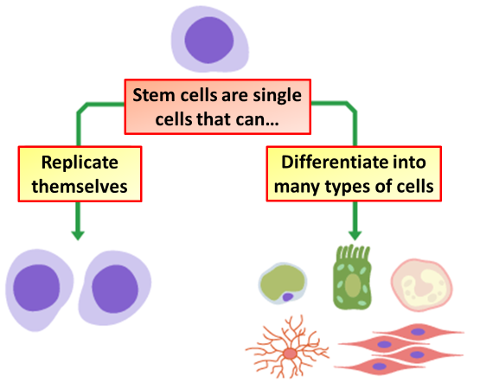

The Great Biology Pubish Quiz
Stem Cells

Slide 2

The Great Biology Pubish Quiz
Stem Cells
What is a defining characteristic of stem cells?
A
They can divide indefinitely and differentiate into various cell types
They are only found in embryos
B
C
They cannot divide by mitosis
D
They have the same function as somatic cells

Slide 3
The Great Biology Pubish Quiz
Stem Cells
What type of stem cell can differentiate into any cell type in the body, including extra-embryonic tissues?
A
Multipotent
Pluripotent
B
C
Totipotent
D
Unipotent

Slide 4
The Great Biology Pubish Quiz
Stem Cells
Which of the following is a potential use of stem cells in medicine?
A
Treating degenerative diseases like Parkinson’s
Producing red blood cells for immune response
B
C
Increasing the rate of mitosis in somatic cells
D
Preventing apoptosis in damaged cells

Slide 5
The Great Biology Pubish Quiz
Stem Cells
Where are haematopoietic stem cells primarily found in adults?
A
Skin
Liver
B
C
Bone marrow
D
Brain

Slide 6
The Great Biology Pubish Quiz
Stem Cells
What is the main ethical concern regarding embryonic stem cell research?
A
High cost of research
Potential rejection of stem cell transplants
B
C
Potential rejection of stem cell transplants
D
Destruction of human embryos

Slide 7
The Great Biology Pubish Quiz
Stem Cells
Which term describes stem cells that can only differentiate into a few closely related cell types?
A
Totipotent
B
Pluripotent
C
Omnipotent
D
Multipotent

Slide 8

The Great Biology Pubish Quiz
Stem Cells
Question 1
A
Question 2
C
Question 3
A
Question 4
C
Question 5
C
Question 6
D

