Slide 1
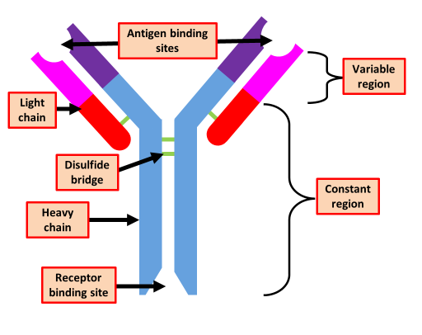

Antibodies & Antigens Question
Compare antibodies and antigens in terms of their structure and role in the immune response.
___________________________________________________________________________________________________________________________________________________________________________________________________________________________________________________________________________________________________________________________________________________________________________________________________________________________________________________________________________________________________________________________________________________________________________________________________________________________________
Answer
Link to video

