Slide 1
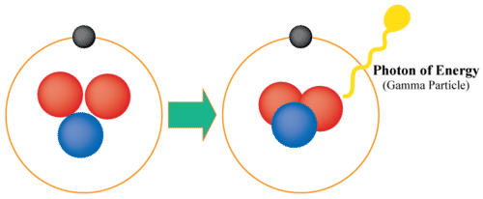

Gamma Radiation Question
Describe the properties of gamma radiation and explain one way it can be harmful to living organisms. (4 marks)
Key things to include:
What makes up Gamma radiation
What are it’s properties
What effect will it have on cells
___________________________________________________________________________________________________________________________________________________________________________________________________________________________________________________________________________________________________________________________________________________________________________________________________________________________________________________________________________________________________________________________________________________________________________________________________________________________________
Answer
Link to video

