Slide 1
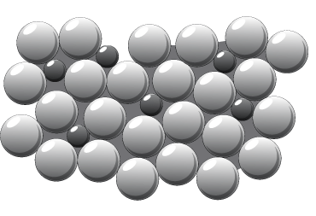

Alloys Question
The diagram below shows the structure of an alloy. Describe the difference between metals and alloys.
Key things to include:
Describe the arrangement of atoms in a metal
Describe the arrangement of the atoms in an alloy
___________________________________________________________________________________________________________________________________________________________________________________________________________________________________________________________________________________________________________________________________________________________________________________________________________________________________________________________________________________________________________________________________________________________________________________________________________________________________
Answer
Link to video

