Slide 1
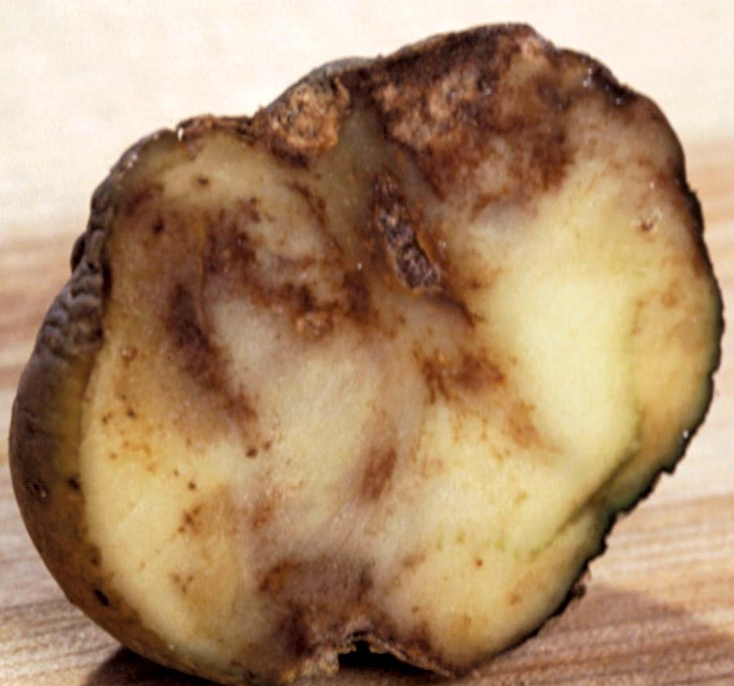

Potato Blight Question
Describe the cause, transmission, and effects of potato blight in plants
____________________________________________________________________________________________________________________________________________________________________________________________________________________________________________________________________________________________________________________________________________________________________________________________________________________________________________________________________________________________________________________________________________________________________________________
Answer
Video link

