Slide 1
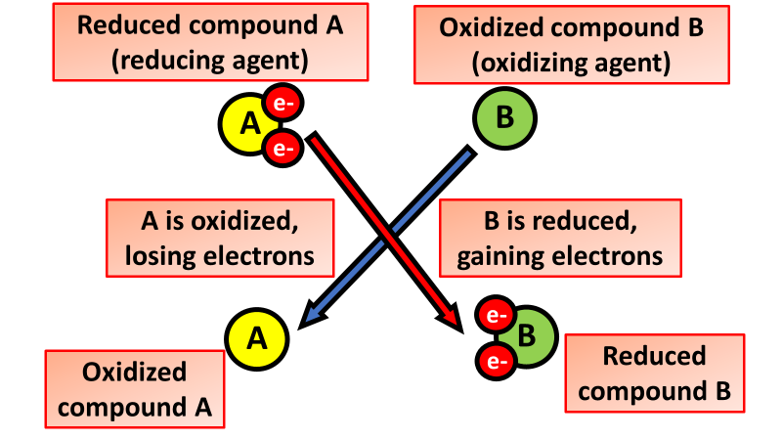

Metal Oxides Question
The diagram shows what happens during a redox reaction
Video Link
What is oxidation?
What is formed when magnesium reacts with oxygen?
Which gas is needed for a metal to oxidise?
What happens to iron when it oxidises in the presence of water and oxygen?

