Slide 1
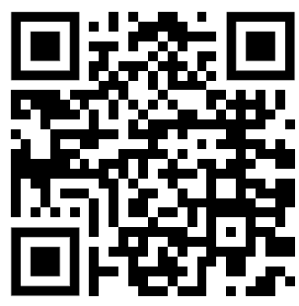
Electrophoresis Errors Question
A student is performing gel electrophoresis to separate DNA fragments. They prepare the gel using water instead of buffer, load too much DNA sample into each well, run the gel with electrodes connected the wrong way round, and stop the run after only 2 minutes.
Identify two major errors in the student’s method. For each, explain why it is incorrect and how it should be corrected.
________________________________________________________________________________________________________________________________________________________________________________________________________________________________________________________________________________________________________________________________________________________________________________________________________________________________________________________________________________________________________________________________________
Answer
Video link

