Slide 1
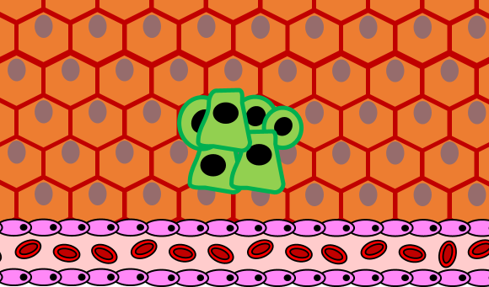
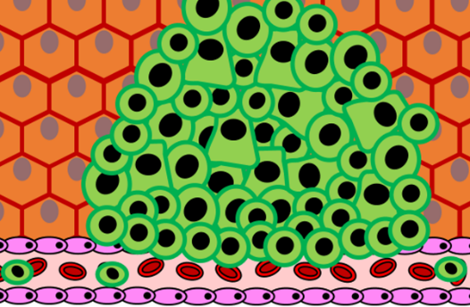

Cancer Practice Question
The diagrams below show the difference from when a tumour starts developing in comparison to when it is developed:
Describe in detail how a tumour develops
Key things to include:
What causes a cell to become cancerous
How does a tumour become malignant
How does a tumour spread
______________________________________________________________________________________________________________________________________________________________________________________________________________________________________________________________________________________________________________________________________________________________________________________________________________________________________________________________________________________
Answer
Link to video

Slide 2

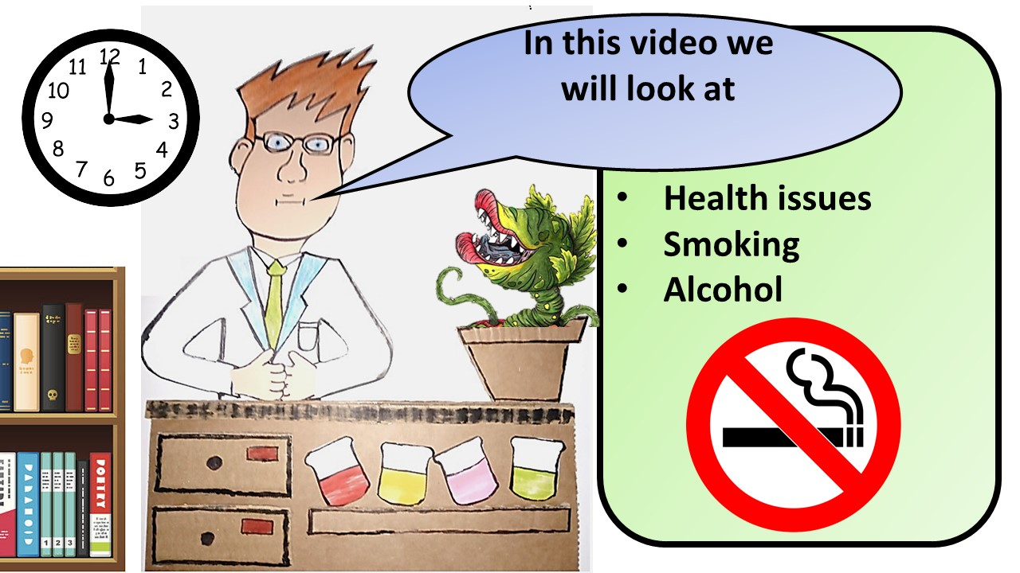


Click here to access my health youtube videos
Resources that this activity would work well with
Lesson on TES
Follow me on social media to stay in touch
Keep up to date with my new content:

