Slide 1
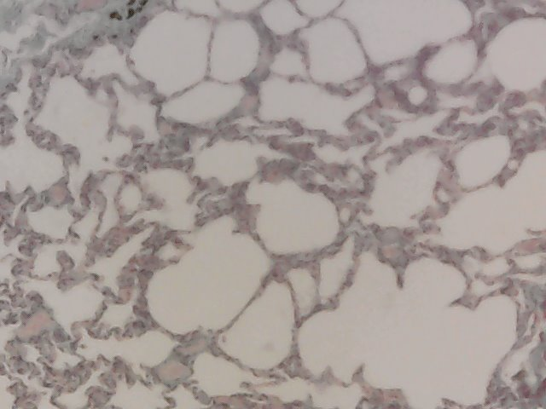

Using a Light Microscope to Examine Lung Tissue Question
Describe how you would use a light microscope to examine lung tissue and produce an annotated drawing as part of a required practical.
____________________________________________________________________________________________________________________________________________________________________________________________________________________________________________________________________________________________________________________________________________________________________________________________________________________________________________________________________________________________________________________________________________________________________________________
Answer
Video link

