Slide 1

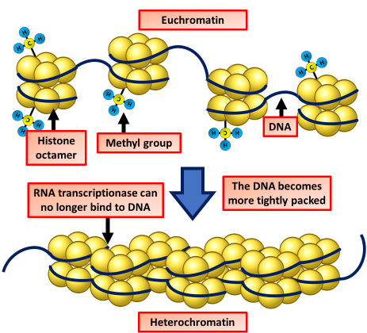

The Great Biology Pubish Quiz
Heterochromatin

Slide 2

The Great Biology Pubish Quiz
Heterochromatin
Heterochromatin is typically found in a DNA state that is:
A
Loose
Relaxed
B
C
Uncoiled
D
Condensed

Slide 3
The Great Biology Pubish Quiz
Heterochromatin
Heterochromatin is generally:
A
Active
Expressed
B
C
Transcribed
D
Inactive

Slide 4
The Great Biology Pubish Quiz
Heterochromatin
Heterochromatin is rich in:
A
Genes
AT-pairs
B
C
Repeats
D
Exons

Slide 5
The Great Biology Pubish Quiz
Heterochromatin
Which type of chromatin is more tightly packed?
A
Heterochromatin
Euchromatin
B
C
Prochromatin
D
Nucleochromatin

Slide 6
The Great Biology Pubish Quiz
Heterochromatin
A function of heterochromatin is to maintain:
A
Transcription
B
Metabolism
C
Genome
D
Protein

Slide 7
The Great Biology Pubish Quiz
Heterochromatin
Heterochromatin is often found at the:
A
Introns
Promoters
B
C
Telomeres
D
Ribosomes

Slide 8

The Great Biology Pubish Quiz
Heterochromatin
Question 1
D
Question 2
D
Question 3
C
Question 4
A
Question 5
C
Question 6
C

