Slide 1
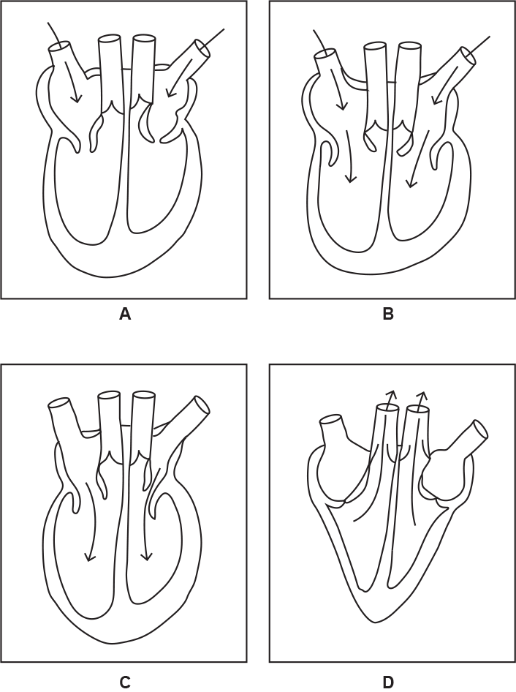

Cardiac Cycle Question
The diagram shows the stages of the cardiac cycle. Explain the cardiac cycle
____________________________________________________________________________________________________________________________________________________________________________________________________________________________________________________________________________________________________________________________________________________________________________________________________________________________________________________________________________________________________________________________________________________________________________________
Answer
Video link

