Slide 1

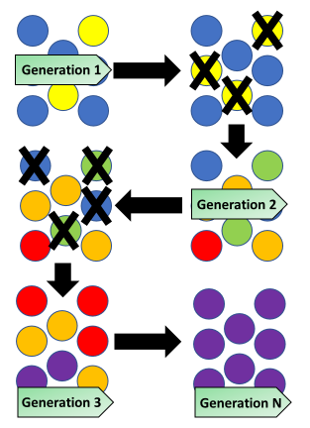

The Great Biology Pubish Quiz
Evolution

Slide 2

The Great Biology Pubish Quiz
Evolution
What is the term for the gradual change in species over time?
A
Evolution
Mutation
B
C
Selection
D
Adaptation

Slide 3
The Great Biology Pubish Quiz
Evolution
Which process involves the survival and reproduction of individuals with favorable traits?
A
Mutation
Selection
B
C
Drift
D
Speciation

Slide 4
The Great Biology Pubish Quiz
Evolution
What is a permanent, heritable change in a DNA sequence called?
A
Mutation
Migration
B
C
Evolution
D
Adaptation

Slide 5
The Great Biology Pubish Quiz
Evolution
What is the transfer of genetic material between populations known as?
A
Drift
Evolution
B
C
Selection
D
Migration

Slide 6
The Great Biology Pubish Quiz
Evolution
Which mechanism involves random fluctuations in allele frequencies in a population?
A
Mutation
Selection
B
C
Drift
D
Adaptation

Slide 7
The Great Biology Pubish Quiz
Evolution
What is the process of forming new species from genetic divergence called?
A
Speciation
B
Evolution
C
Migration
D
Selection

Slide 8

The Great Biology Pubish Quiz
Evolution
Question 1
A
Question 2
B
Question 3
A
Question 4
D
Question 5
C
Question 6
A

