Slide 1

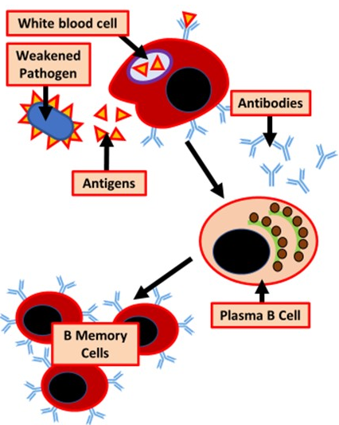

The Great Biology Pubish Quiz
Vaccination

Slide 2

The Great Biology Pubish Quiz
Vaccination
What is the primary purpose of a vaccine?
A
To directly kill pathogens in the body
To stimulate the production of memory cells
B
C
To neutralize toxins produced by pathogens
D
To provide passive immunity

Slide 3
The Great Biology Pubish Quiz
Vaccination
Which component of a vaccine triggers an immune response?
A
Live, pathogenic microbes
Harmless forms of antigens
B
C
Fully functional antibodies
D
Plasma cells

Slide 4
The Great Biology Pubish Quiz
Vaccination
What type of immunity is gained through vaccination?
A
Passive natural immunity
Passive artificial immunity
B
C
Active natural immunity
D
Active artificial immunity

Slide 5
The Great Biology Pubish Quiz
Vaccination
Which of the following describes herd immunity?
A
Immunity acquired by individuals with repeated vaccinations
Protection provided to unvaccinated individuals when most of the population is vaccinated
B
C
A scenario where only young individuals are vaccinated
D
Immunity provided through passive antibody transfer

Slide 6
The Great Biology Pubish Quiz
Vaccination
Why are booster doses of a vaccine sometimes required?
A
To eliminate remaining pathogens
To provide passive immunity
B
To replace memory cells that have been lost over time
C
D
To reduce the severity of side effects

Slide 7
The Great Biology Pubish Quiz
Vaccination
Which of these is an example of a live attenuated vaccine?
A
The measles, mumps, and rubella (MMR) vaccine
B
The tetanus vaccine
C
The inactivated polio vaccine (IPV)
D
The hepatitis B vaccine

Slide 8

The Great Biology Pubish Quiz
Vaccination
Question 1
B
Question 2
B
Question 3
D
Question 4
B
Question 5
C
Question 6
A

