Slide 1
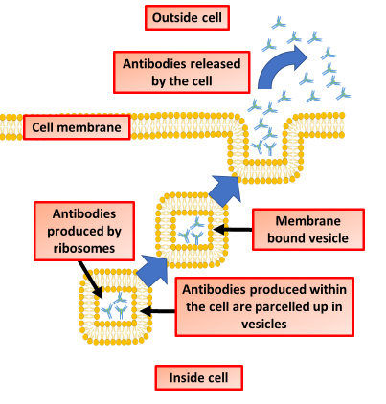

Exocytosis Question
The diagram shows the process of exocytosis. Describe the process of exocytosis and its role in cells.
____________________________________________________________________________________________________________________________________________________________________________________________________________________________________________________________________________________________________________________________________________________________________________________________________________________________________________________________________________________________________________________________________________________________________________________
Answer
Video link

