Slide 1
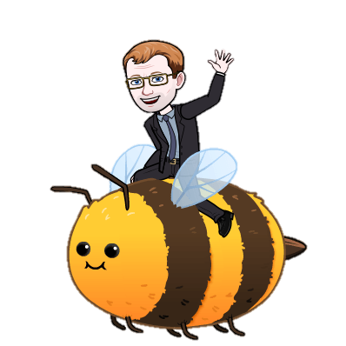
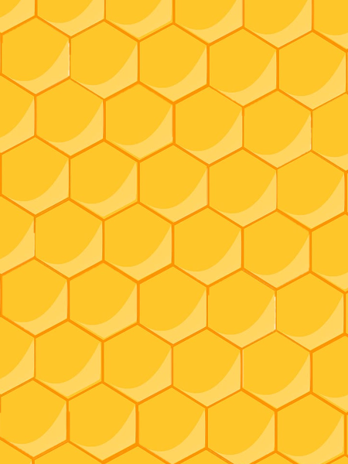
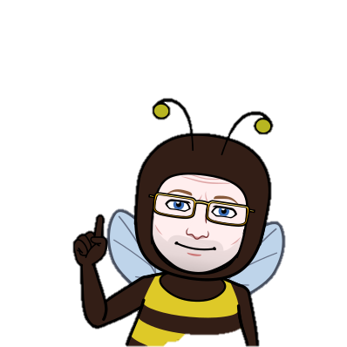
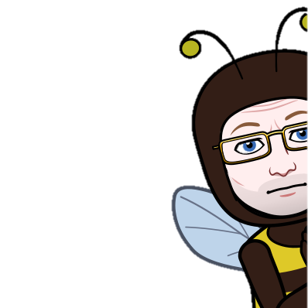
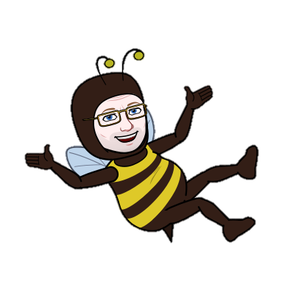

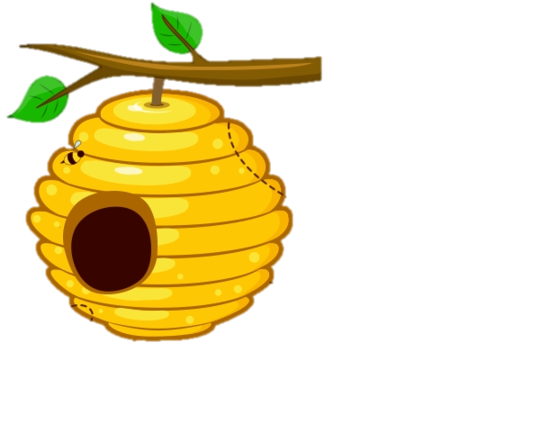
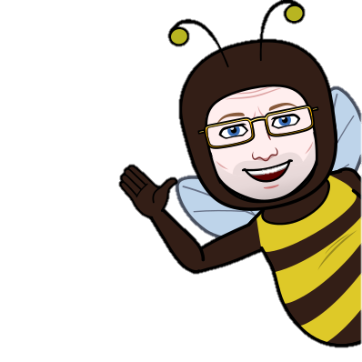
Bee-aware of bees!
Bees are incredibly important to the world because they carry out pollination. Design a small habitat for bees to live in. Some areas of information you might want to include are shown below
How pollination is carried out by bees
Types of bee in a hive
Pollination is the act of transferring pollen grains from the male anther of a flower to the female stigma. The goal of every living organism, including plants, is to create offspring for the next generation
There are three types of honey bees within a hive: the queen, the workers, and the drones. A queen bee is the only female bee in the hive that gets to reproduce. Worker bees are all female, and are all offspring of the queen. But there are males in the hive called drones
What do bees drink?
How bees ventilate the hive
In the summer bees will line up at the entrance of the hive and flap their wings furiously, to push around into the hive.
In addition to a place for brood, pollen and nectar/honey, bees need a ready source of water to hydrate the hive. By the way, they are not particular! In fact, they seem to have a preference for somewhat dirty water.
What bees eat
Honey bees collect pollen & nectar from a variety of flowering plants, including milkweed, dandelions, clover, goldenrod and a variety of fruit trees. Only workers forage for food, consuming as much nectar from each flower as they can.
Bees & Honey
How much sun do bees need?
The honeycomb forms the inside of the hive, like a food pantry. As it sits in the honeycomb cells, the water in the nectar dries out and the nectar gets thicker, becoming honey.
Bees seem to like the sun, not least of which is that it sends a message that the day is suitable for foraging.

