Slide 1
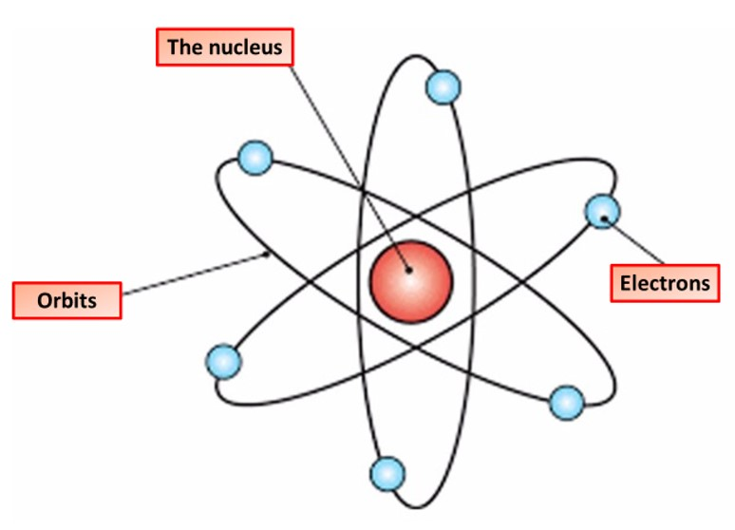

Structure of an Atom Question
The diagram shows the structure of an atom. Describe the structure of an atom, including the arrangement of subatomic particles.
Key things to include:
The location of protons, neutrons & electrons
The mass of protons, neutrons & electrons
_______________________________________________________________________________________________________________________________________________________________________________________________________________________________________________________________________________________________________________________________________________________________________________________________________________________________________
Answer
Link to video

