Slide 1
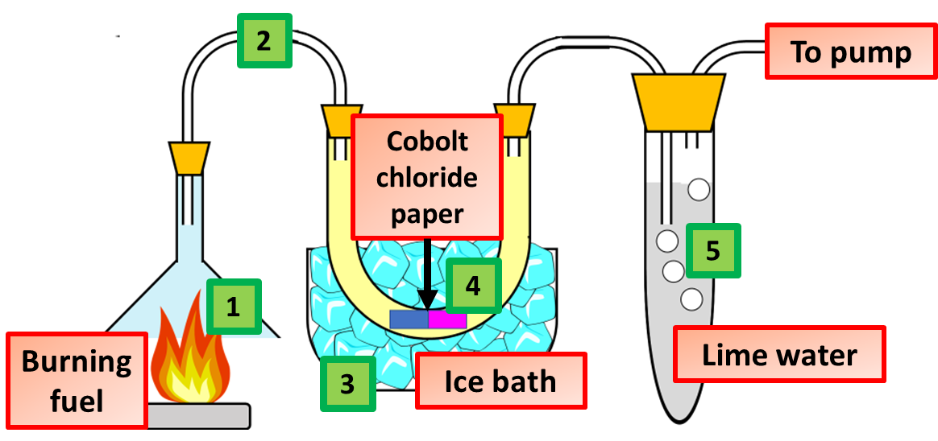
Combustion Practice Question
This apparatus was used to study the combustion of a hydrocarbon fuel. Describe what happens when fuel burns stating how the products from combustion can be identified using the equipment above.
Key things to include:
What reaction takes place
How us water detected
How is carbon dioxide detected
Answer
_____________________________________________________________________________________________________________________________________________________________________________________________________________________________________________________________________________________________________________________________________
Link to video

Slide 2
Combustion Practice Question

