Slide 1
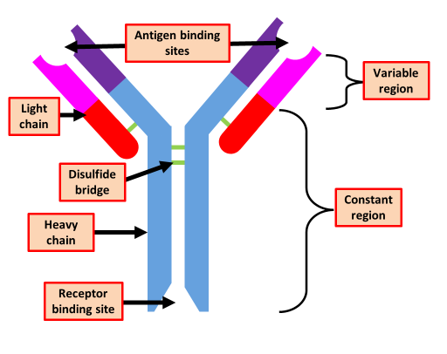
Antibody Structure Question
Describe the structure of an antibody and explain how this allows it to carry out its function.
___________________________________________________________________________________________________________________________________________________________________________________________________________________________________________________________________________________________________________________________________________________________________________________________________________________________________________________________________________________________________________________________________________________________________________________________________________________________________
Answer
Link to video

