Slide 1


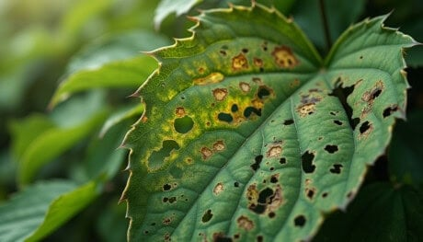
The Great Biology Pubish Quiz
Plant Disease

Slide 2

The Great Biology Pubish Quiz
Plant Disease
Which pathogen causes the plant disease tobacco mosaic virus (TMV)?
A
Bacteria
Virus
B
C
Fungi
D
Protist

Slide 3
The Great Biology Pubish Quiz
Plant Disease
Which plant disease is caused by the fungus Mycosphaerella fijiensis?
A
Ring rot
Potato blight
B
C
Crown gall disease
D
Black Sigatoka

Slide 4
The Great Biology Pubish Quiz
Plant Disease
Which plant disease is caused by the bacterium Clavibacter michiganensis?
A
Potato blight
Black Sigatoka
B
C
Ring rot
D
TMV

Slide 5
The Great Biology Pubish Quiz
Plant Disease
Which type of organism causes potato blight?
A
Bacterium
Virus
B
C
Fungus
D
Protoctist

Slide 6
The Great Biology Pubish Quiz
Plant Disease
Which of the following plant diseases is mainly spread through soil and infected seed tubers?
A
Ring rot
Potato blight
B
C
Black Sigatoka
D
TMV

Slide 7
The Great Biology Pubish Quiz
Plant Disease
Which plant disease leads to yellow and brown streaking of leaves and stunted growth?
A
Potato blight
B
TMV
C
Black Sigatoka
D
Ring rot

Slide 8

The Great Biology Pubish Quiz
Plant Disease
Question 1
B
Question 2
D
Question 3
C
Question 4
D
Question 5
A
Question 6
B

