Slide 1
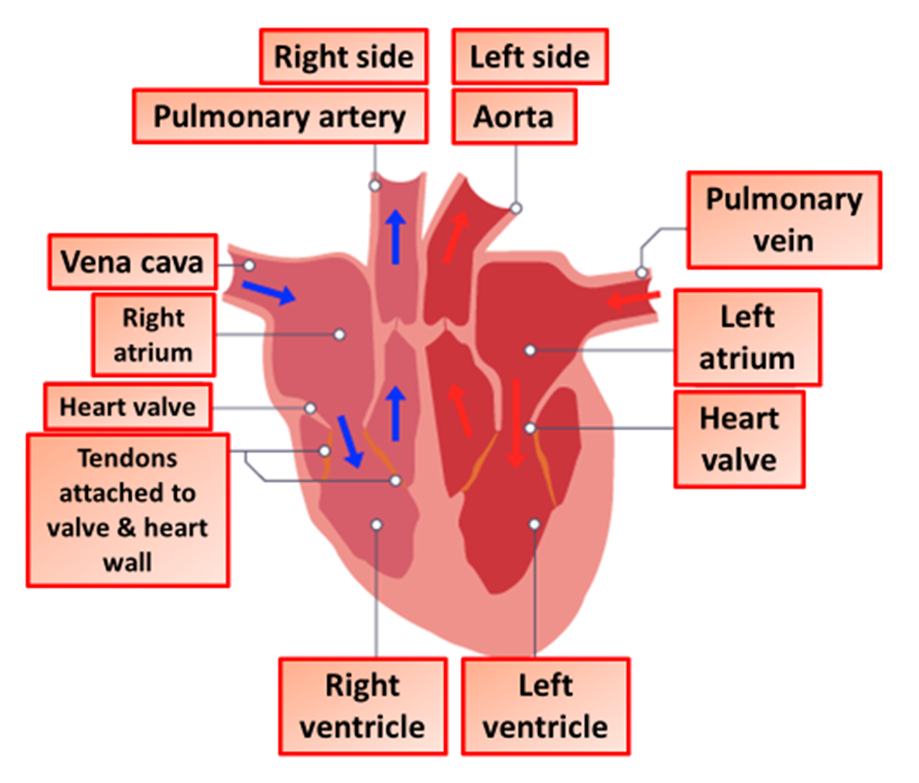

The Heart Question
The diagram shows the structure of the heart. Describe the structure of the heart and explain how it pumps blood around the body.
Key things to include:
How does blood move through the right side of the heart
How does blood move through the left side of the heart
_______________________________________________________________________________________________________________________________________________________________________________________________________________________________________________________________________________________________________________________________________________________________________________________________________________________________________
Answer
Link to video

