Slide 1
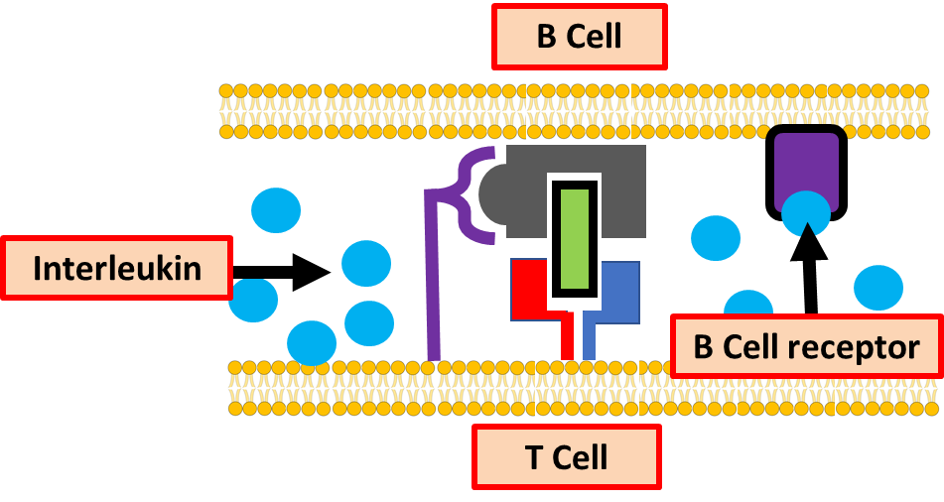
The Activation of B Cells Question
Describe how T helper cells activate B cells during the immune response.
___________________________________________________________________________________________________________________________________________________________________________________________________________________________________________________________________________________________________________________________________________________________________________________________________________________________________________________________________________________________________________________________________________________________________________________________________________________________________
Answer
Link to video

