Slide 1
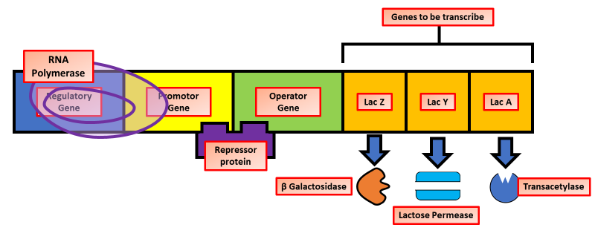
Lac Operon Question
Explain how the lac operon controls the production of enzymes in bacteria when lactose is present
____________________________________________________________________________________________________________________________________________________________________________________________________________________________________________________________________________________________________________________________________________________________________________________________________________________________________________________________________________________________________________________________________________________________________________________
Answer
Video link

