Slide 1
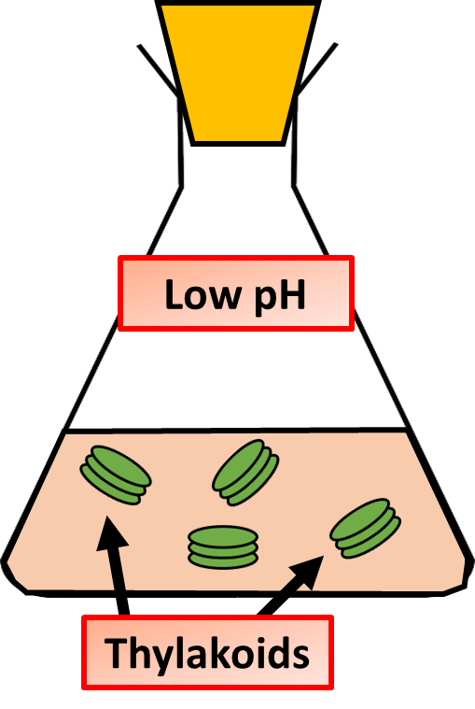
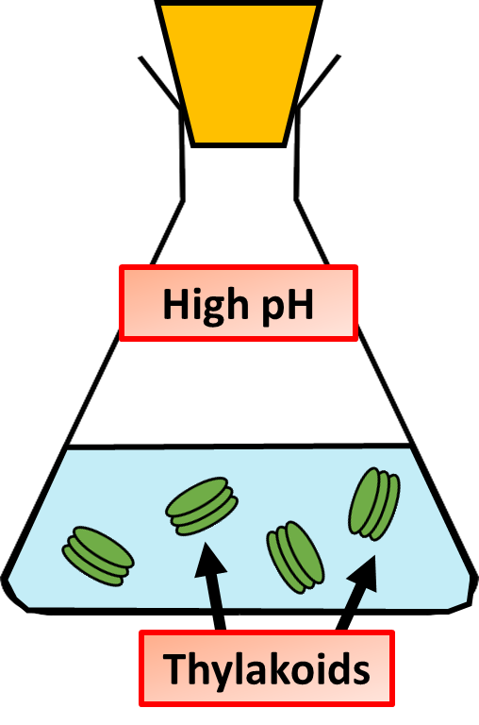

Evidence of Chemiosmosis Question
Describe the key findings of Andre Jagendorf's experiment on chemiosmosis and explain its significance in understanding ATP synthesis.
____________________________________________________________________________________________________________________________________________________________________________________________________________________________________________________________________________________________________________________________________________________________________________________________________________________________________________________________
Answer
Video link

