Slide 1
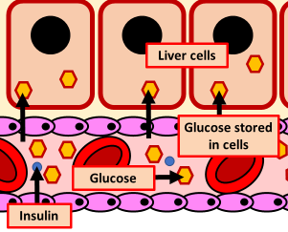

Insulin Question
The diagram below shows the effect of insulin on the body
Video Link
What hormone controls blood glucose levels?
Where is insulin produced in the body?
What does insulin do to blood glucose levels?
How does insulin lower blood glucose levels?

