Slide 1
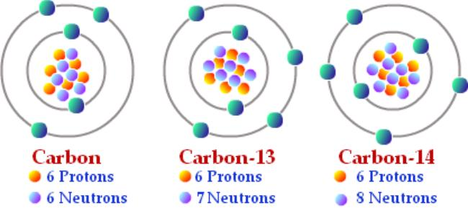

Isotopes Practice Question
Some isotopes emit nuclear radiation. Carbon-14 and carbon-12 are isotopes of carbon. Compare the structure of an atom of carbon-14 with the structure of an atom of carbon-12.
Key things to include:
Compare the number of protons
Compare the number of electrons
Compare the number of neutrons
Answer
_________________________________________________________________________________________________________________________________________________________________________________________________________________________________________________________________________________________________________________________________________
Link to video

Slide 2
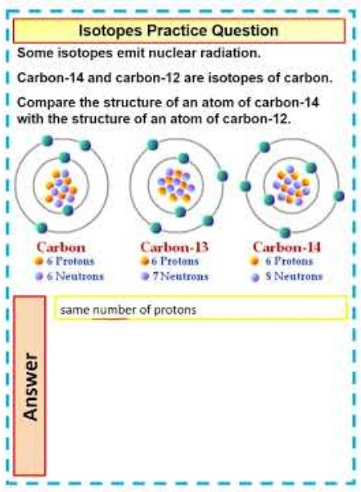
Isotopes Practice Question

