Slide 1
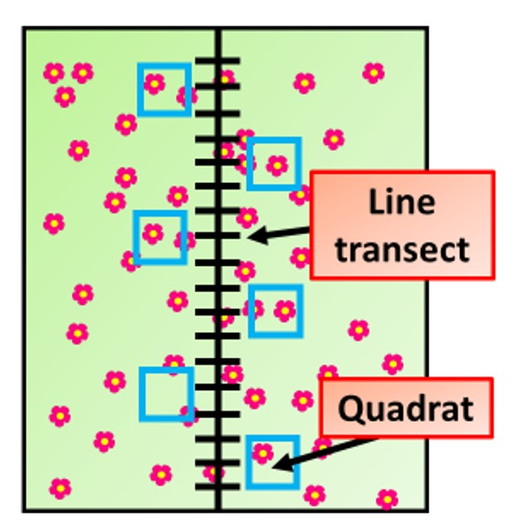
Correlation Between Species and Biotic / Abiotic Factors Question
Describe how you would investigate the correlation between the distribution of a plant species and an abiotic factor in a habitat.

