Slide 1
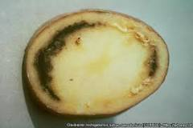

Ring Rot Question
Explain the cause, transmission, and impact of ring rot in plants
____________________________________________________________________________________________________________________________________________________________________________________________________________________________________________________________________________________________________________________________________________________________________________________________________________________________________________________________________________________________________________________________________________________________________________________
Answer
Video link

