Slide 1

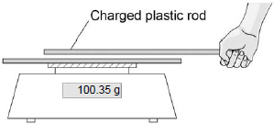

Static Electricity Practice Question
Figure 1 shows the negatively charged rod on a balance.
Figure 2 shows another charged rod being held stationary above the rod on the balance.
The rods do not touch each other. Explain why the reading on the balance increases.
_________________________________________________________________________________________________________________________________________________________________________________________________________________________________________________________________________________________________________________________________________
Answer
Link to video

Slide 2
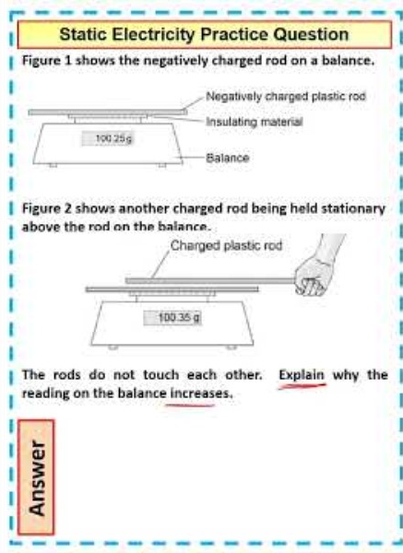
Static Electricity Practice Question

