Slide 1

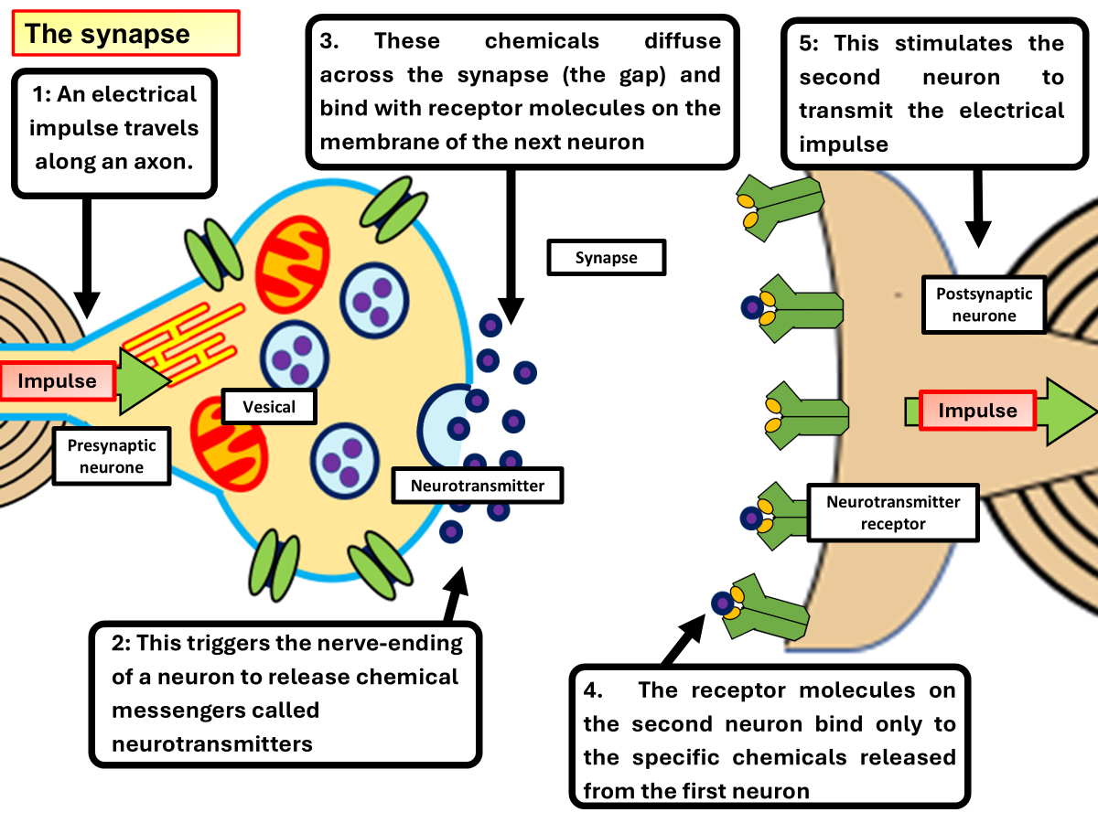

The Great Biology Pubish Quiz
The Synapse

Slide 2

The Great Biology Pubish Quiz
The Synapse
What is the gap between two neurons at a synapse called?
A
Synaptic cleft
Myelin sheath
B
C
Axon hillock
D
Node of Ranvier

Slide 3
The Great Biology Pubish Quiz
The Synapse
Which neurotransmitter is commonly used at neuromuscular junctions?
A
Dopamine
Acetylcholine
B
C
Serotonin
D
Glutamate

Slide 4
The Great Biology Pubish Quiz
The Synapse
What is the role of calcium ions in synaptic transmission?
A
To depolarise the postsynaptic membrane
B
To break down excess neurotransmitters
C
To block sodium ion channels
D
To cause synaptic vesicles to release neurotransmitters

Slide 5
The Great Biology Pubish Quiz
The Synapse
How is a neurotransmitter removed from the synaptic cleft?
A
Active transport
Diffusion
B
C
Enzyme breakdown or reuptake
D
Osmosis

Slide 6
The Great Biology Pubish Quiz
The Synapse
Which type of synapse increases the likelihood of an action potential in the postsynaptic neuron?
A
Inhibitory
Excitatory
B
C
Electrical
D
Depolarisation

Slide 7
The Great Biology Pubish Quiz
The Synapse
What is the main effect of an inhibitory neurotransmitter on the postsynaptic membrane?
A
Depolarisation
B
Increased action potential frequency
C
Hyperpolarisation
D
Sodium ion influx

Slide 8

The Great Biology Pubish Quiz
The Synapse
Question 1
A
Question 2
B
Question 3
D
Question 4
C
Question 5
B
Question 6
C

