Slide 1
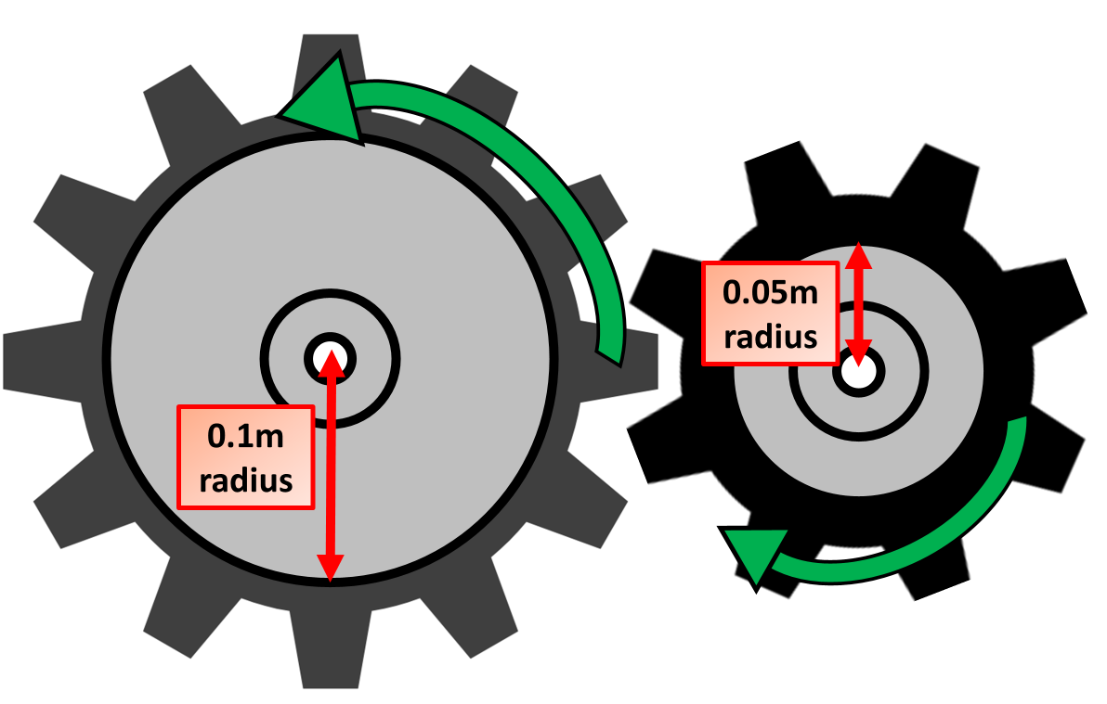

Gears Question
Explain how gears can be used to change the speed or force of a rotating system.
Key things to include:
How is the rotation of gears changed
How is the force of a gear changed
_______________________________________________________________________________________________________________________________________________________________________________________________________________________________________________________________________________________________________________________________________________________________________________________________________________________________________
Answer
Link to video

