Slide 1
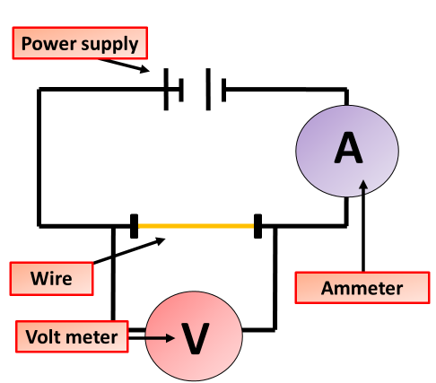

Series Circuits Question
The diagram shows an example of a circuit in series. Explain how a series circuit works and describe its key characteristics.
Key things to include:
Describe the current in a series circuit
Describe the voltage in a series circuit
What would happen if a component is removed
________________________________________________________________________________________________________________________________________________________________________________________________________________________________________________________________________________________________________________________________________________________________________________________________________________________________________
Answer
Link to video

