Slide 1
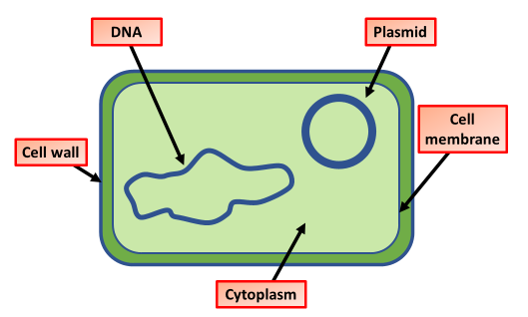

Bacteria Question
The diagram shows the structure of a bacteria cell
Video Link
What are bacteria?
Are bacteria prokaryotic or eukaryotic?
Name one common shape of bacteria
How do most bacteria reproduce?

