Slide 1
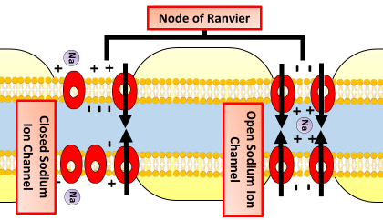


The Great Biology Pubish Quiz
Saltatory Conduction

Slide 2

The Great Biology Pubish Quiz
Saltatory Conduction
Where does saltatory conduction occur in a neurone?
A
Dendrites
Synapse
B
C
Axon
D
Soma

Slide 3
The Great Biology Pubish Quiz
Saltatory Conduction
What are the gaps between myelin sheaths called?
A
Axon hillocks
Nodes
B
C
Terminals
D
Channels

Slide 4
The Great Biology Pubish Quiz
Saltatory Conduction
Which ion primarily moves during the depolarisation at the node?
A
Chloride
Potassium
B
C
Sodium
D
Calcium

Slide 5
The Great Biology Pubish Quiz
Saltatory Conduction
What type of conduction is saltatory conduction compared to?
A
Continuous
Passive
B
C
Reflexive
D
Sympathetic

Slide 6
The Great Biology Pubish Quiz
Saltatory Conduction
Saltatory conduction increases the speed of what?
A
Synaptic vesicle release
Hormone diffusion
B
C
Neurotransmitter breakdown
D
Nerve impulse

Slide 7
The Great Biology Pubish Quiz
Saltatory Conduction
Myelin acts as an electrical what?
A
Conductor
B
Generator
C
Inhibitor
D
Insulator

Slide 8

The Great Biology Pubish Quiz
Saltatory Conduction
Question 1
C
Question 2
B
Question 3
C
Question 4
A
Question 5
D
D

