Slide 1
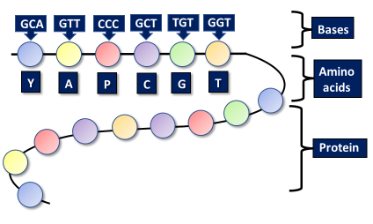
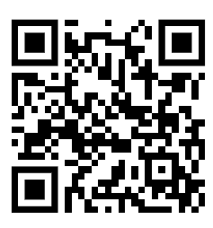
Protein Synthesis Practice Question
The diagram below shows an outline of protein synthesis
Describe how this process leads to the production of new proteins
Key things to include:
What transcription is
What translation is
_____________________________________________________________________________________________________________________________________________________________________________________________________________________________________________________________________________________________________________________________________________________________________________________________________________________________________________________________________________________________________________________________________
Answer
Link to video

Slide 2
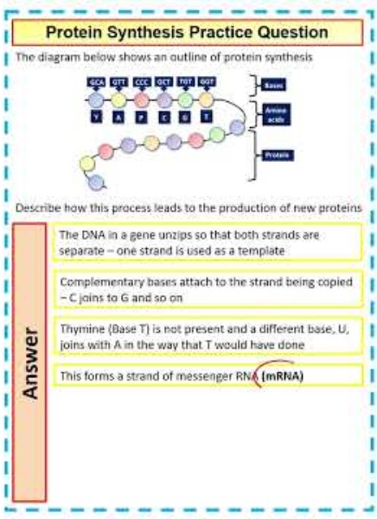
Protein Synthesis Practice Question

Slide 3
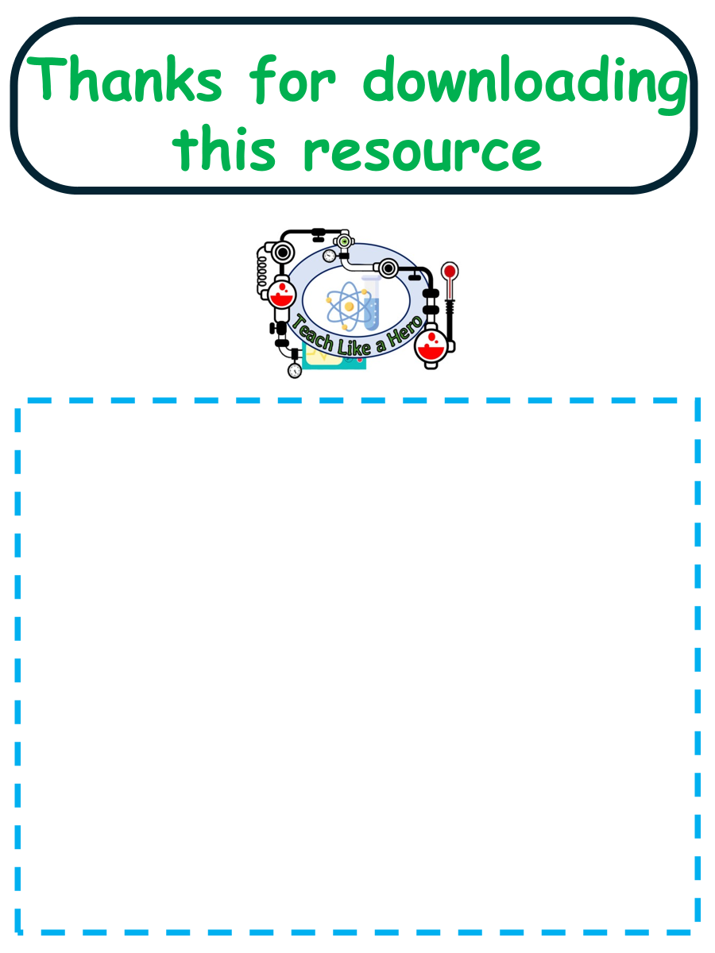
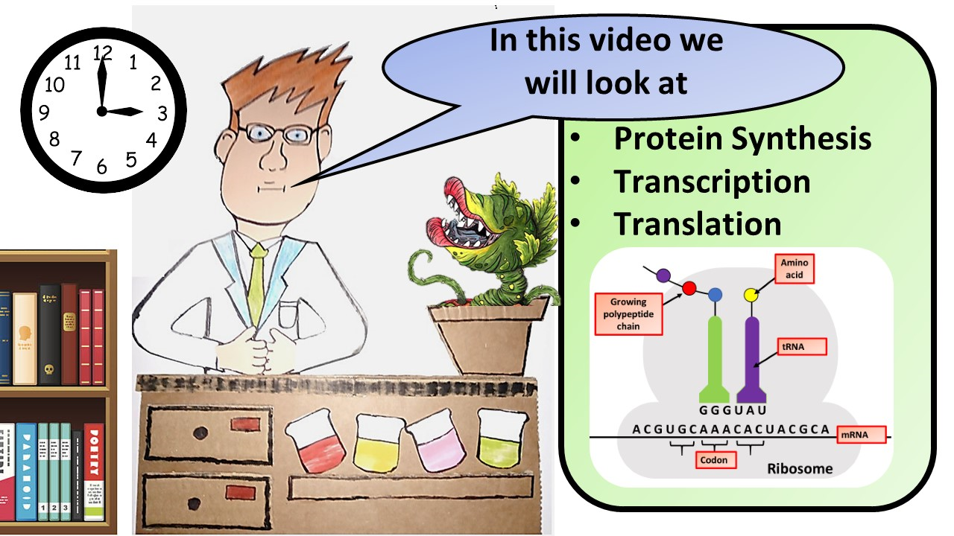


Click here to access my youtube videos
Resources that this activity would work well with
Lesson on TES
Lesson on TPT
Follow me on social media to stay in touch
Keep up to date with my new content:

