Slide 1
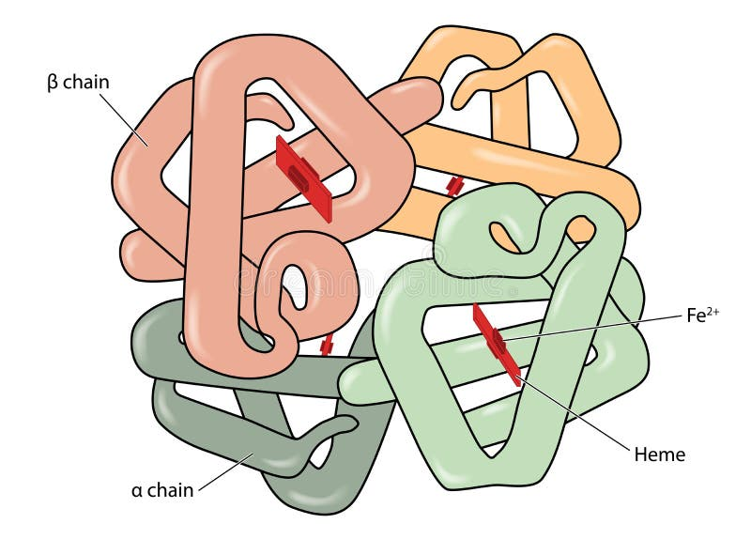
The Structure of Haemoglobin Question
The diagram below shows the structure of Haemoglobin
Describe the structure of haemoglobin and explain how it is related to its function.
________________________________________________________________________________________________________________________________________________________________________________________________________________________________________________________________________________________________________________________________________________________________________________________________________________________________________________________________________________________________________________________________________________________________________________________________________________________________________________________________________________________________________________________________________________________________________________
Answer
Link to video

