Slide 1
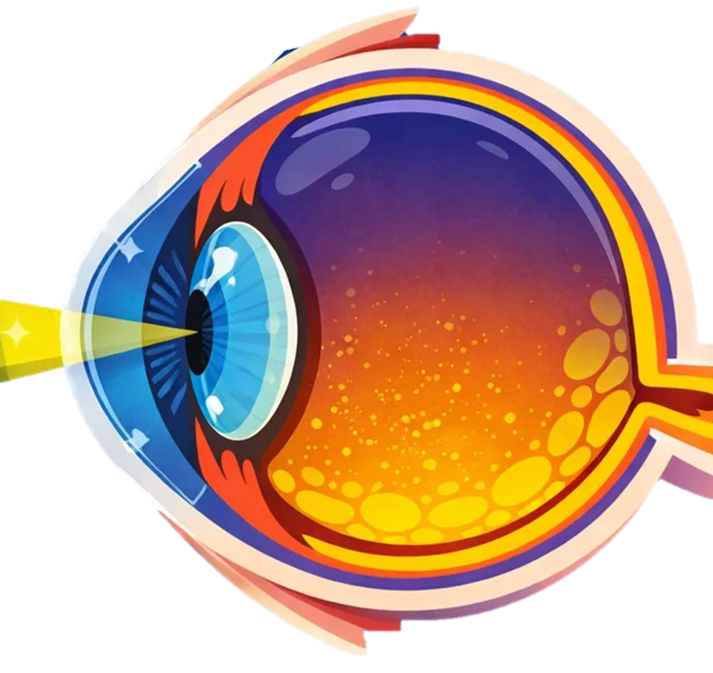
Pupil – The opening in the centre of the iris that allows light to enter the eye.
Ciliary muscles – Muscles that change the shape of the lens to help focus on objects at different distances.
The Structure of the Eye
Cornea – The transparent curved layer at the front of the eye. It refracts (bends) light as it enters the eye to help focus it.
Retina – A layer at the back of the eye containing light-sensitive cells (rods and cones) that detect light and convert it into electrical signals.
Lens – A transparent structure that changes shape to focus light onto the retina. This process is called accommodation.
Optic nerve – The nerve that carries electrical signals from the retina to the brain, where they are interpreted as images.
Pupil – The opening in the centre of the iris that allows light to enter the eye.
Iris – The coloured part of the eye. It controls the size of the pupil to regulate how much light enters the eye.
Sclera – The tough outer layer of the eye that protects the eye and helps maintain its shape.

Slide 2
Pupil – The opening in the centre of the iris that allows light to enter the eye.
Ciliary muscles –
The Structure of the Eye
Cornea –
Retina –
Lens –
Optic nerve –
Pupil –
Iris –
Sclera –

Slide 3
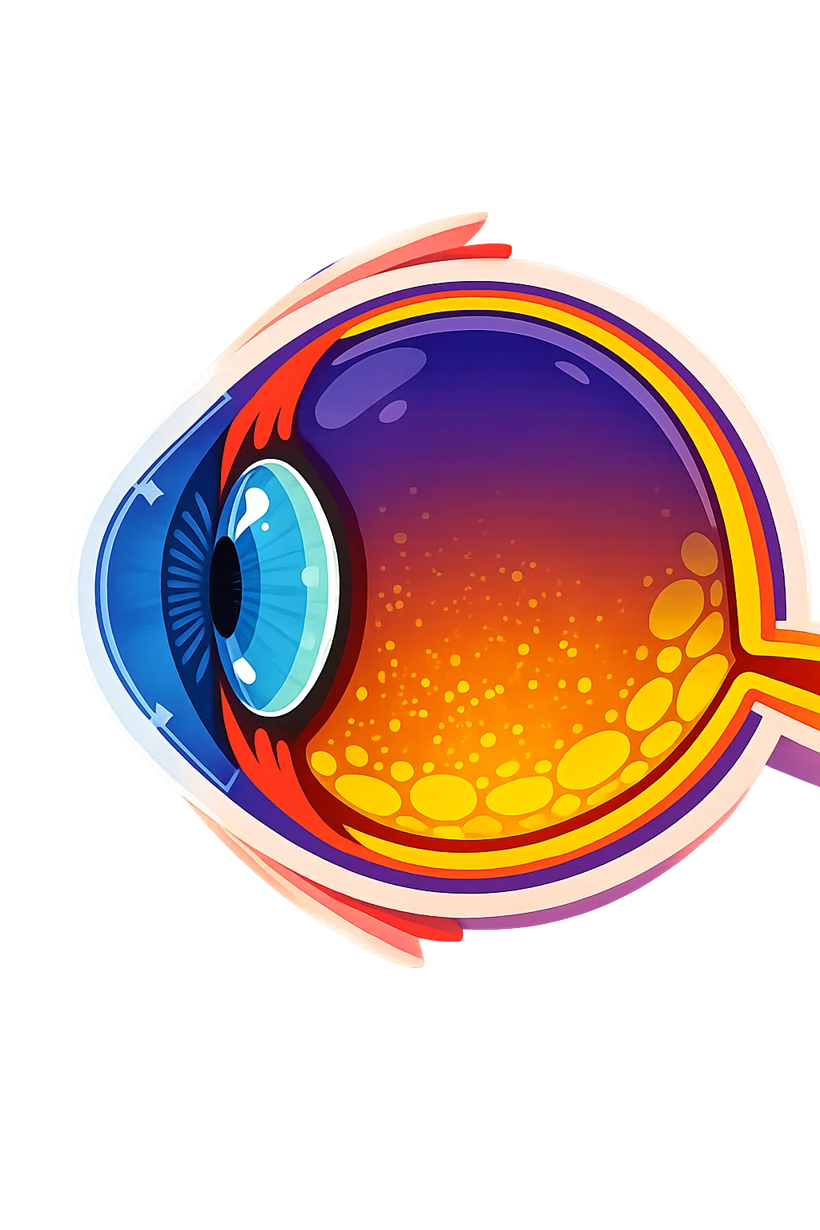
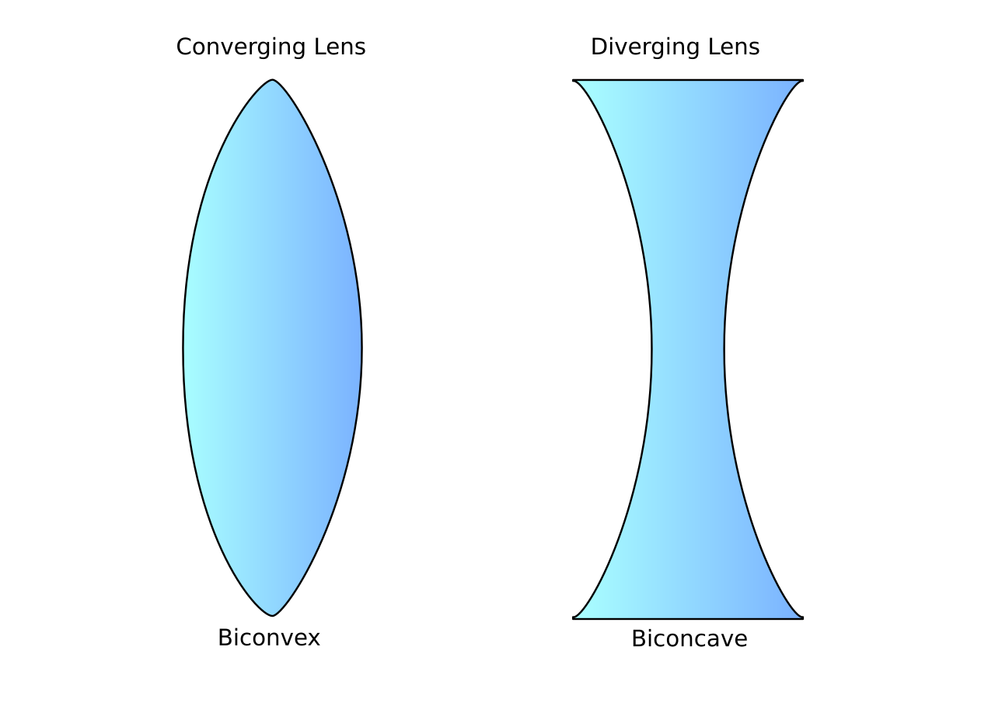
Correcting Long-sightedness
Long-sightedness (hyperopia) means that near objects appear blurry but distant objects can usually be seen clearly.
To correct this problem, convex (converging) lenses are used in glasses or contact lenses.
This occurs because light is focused behind the retina, often because the eyeball is too short or the lens cannot bend light enough.
Focal point
Focal point
Convex Lens
This helps the eye’s lens focus the light sooner inside the eye.
A convex lens bends light rays inward before they enter the eye.
As a result, the light is focused directly onto the retina, allowing nearby objects to be seen clearly

Slide 4
Correcting Short-sightedness
Short-sightedness (myopia) means that distant objects appear blurry but nearby objects can be seen clearly.
To correct this problem, concave (diverging) lenses are used in glasses or contact lenses.
This happens because light is focused in front of the retina, usually because the eyeball is too long or the lens bends light too much.
Focal point
Focal point
Convex Lens
This allows the eye’s lens to focus the light further back in the eye.
A convex lens bends light rays inward before they enter the eye.
As a result, the light is focused correctly onto the retina, allowing distant objects to be seen clearly

Slide 5
Accommodation in the Eye to Distant Objects
Accommodation is the process by which the eye changes the shape of the lens to focus on objects at different distances. The ciliary muscles adjust the thickness of the lens, making it thicker to focus on nearby objects and thinner to focus on distant objects.
Circular Ciliary muscles contract.
Focal point
Light
Reduce the pull on the Suspensory ligaments.
With less force on the lens its elasticity allows it to become wider-decreasing its focal length.
Rays from the near object are brought to focus on the retina.

Slide 6
Accommodation in the Eye to Near Objects
Accommodation is the process by which the eye changes the shape of the lens to focus on objects at different distances. The ciliary muscles adjust the thickness of the lens, making it thicker to focus on nearby objects and thinner to focus on distant objects.
Circular Ciliary muscles relax.
Light
Focal point
Suspensory ligaments are pulled tight
The lens is stretched to become longer and thinner, increasing its focal length.
Rays from the distant object are brought to focus on the retina.

