Slide 1
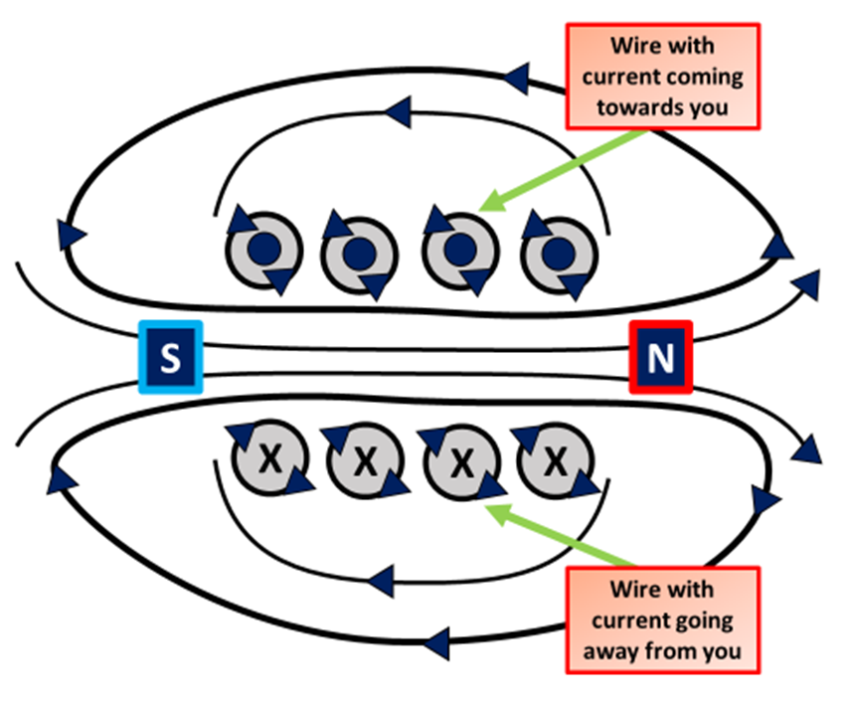

Electromagnet Properties Question
The diagram below shows cross section of an electromagnet
Mark Scheme
What happens to an electromagnet when the current is switched off?
What can be placed inside a coil of wire to make an electromagnet stronger?
How can you increase the strength of an electromagnet?
Are electromagnets permanent or temporary magnets?

