Slide 1
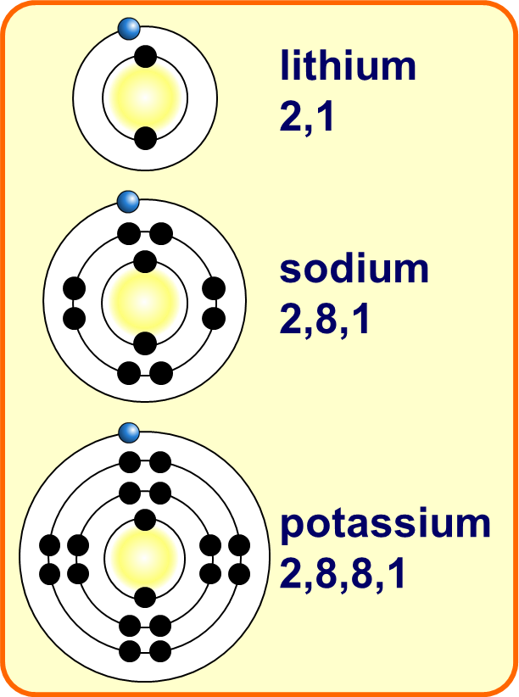

Group 1 Elements Practice Question
Explain why the reactivity of elements changes going down Group 1.
Key things to include:
How many electrons need to be lost
What effect does distance from the nucleus have
________________________________________________________________________________________________________________________________________________________________________________________________________________________________________________________________________________________________________________________________________________________________________________________
Answer
Link to video

Slide 2
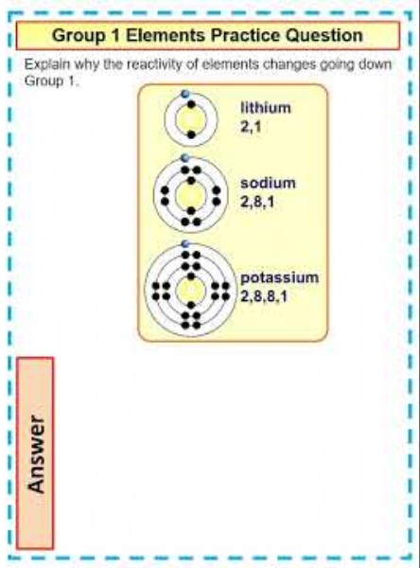
Group 1 Elements Practice Question

