Slide 1
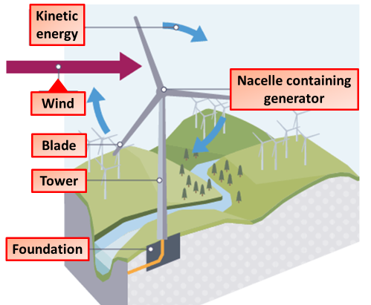
Wind Power
3. Turbine Rotation: As the wind turns the blades, the rotational energy is transferred to the rotor (the central part of the turbine connected to the blades), which begins to spin.
1. Wind Movement: Wind is created by the uneven heating of the Earth's surface by the sun. The movement of air, or wind, contains kinetic energy that can be harnessed.
6. Renewable Process: The wind continues to blow, and the turbines keep spinning, producing electricity without emitting greenhouse gases, making it a sustainable and renewable source of energy.
2. Wind Turbine Blades: Wind flows over the blades of a wind turbine, causing them to spin. The design of the blades is optimized to capture as much energy as possible from the wind.
4. Generator Activation: The rotor is connected to a generator. As the rotor spins, it turns a shaft inside the generator. This movement causes magnets to move past coils of wire, generating an electric current through electromagnetic induction.
5. Electricity Transmission: The electricity generated by the wind turbine is transmitted through power lines to homes, businesses, and industries.

Slide 2
Tidal Power
5. Electricity Transmission: The generated electricity is transmitted through power lines to homes, businesses, and other facilities.
1. Harnessing Tidal Movement: Tidal power plants are typically built in areas with strong tidal currents or significant tidal ranges (the difference between high and low tides).
3. Turbine Activation: As the water moves in or out (during rising or falling tides), it flows through turbines. The kinetic energy of the moving water causes the turbine blades to spin, converting kinetic energy into mechanical energy.
2. Water Collection: As the tide rises, water flows into a reservoir or through tidal turbines. The gravitational pull of the moon and sun creates this movement, which is predictable and consistent.
6. Renewable Cycle: Tidal movements are driven by the gravitational pull of celestial bodies and the Earth's rotation, ensuring that the process is sustainable and reliable over time.
4. Electricity Generation: The spinning turbines drive generators. As the turbine rotates, it turns a rotor inside the generator, which is surrounded by magnets and coils of wire. This movement induces an electric current through electromagnetic induction.

Slide 3
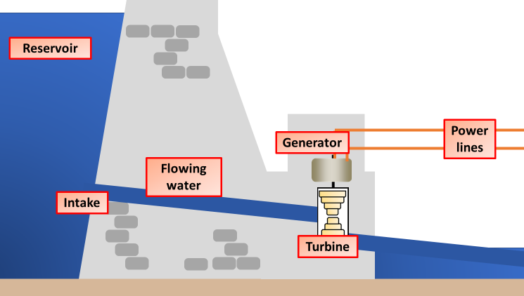
Hydroelectricity
4. Electricity Generation: The spinning turbine is connected to a generator. As the turbine rotates, it turns the rotor inside the generator, which is surrounded by coils of wire and magnetic fields. This movement induces an electric current through electromagnetic induction.
1. Water Flow Collection: A dam is built to store water in a reservoir, creating potential energy due to the height of the water above the turbines.
5. Electricity Transmission: The generated electricity is transmitted through power lines to homes, businesses, and industries for use.
2. Release of Water: When electricity is needed, water is released from the reservoir through pipes called penstocks. The gravitational force causes the water to flow rapidly, converting potential energy into kinetic energy.
3. Turbine Rotation: The flowing water strikes the blades of a turbine, causing it to spin. The kinetic energy of the water is transferred to the turbine, converting it into mechanical energy.
6. Water Reuse: The water flows out of the turbines and back into the river or reservoir, ensuring a continuous cycle without depletion.

Slide 4
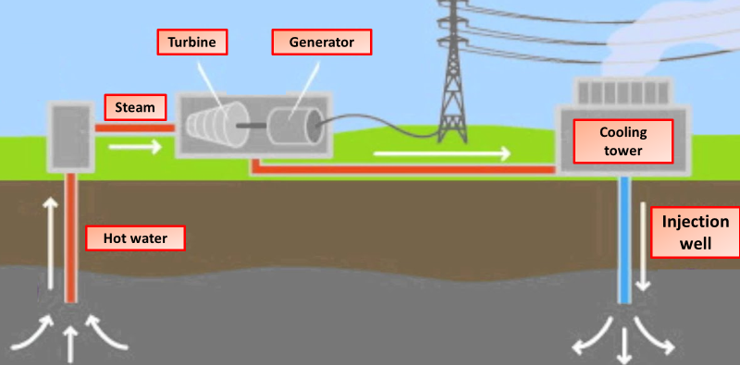
Geothermal Power
5. Electricity Generation: The turbine is connected to a generator. As the turbine spins, it turns a rotor inside the generator, which is surrounded by coils of wire and magnets. This induces an electric current through electromagnetic induction.
4. Turbine Activation: The steam flows through pipes to a turbine, causing it to spin. The mechanical energy of the spinning turbine is converted into rotational energy.
3. Extracting Steam: In many geothermal power plants, the extracted hot water is directed to the surface where it is used to produce steam. This steam is typically used to drive turbines.
6. Electricity Transmission: The generated electricity is then transmitted through power lines to homes, businesses, and industries.
2. Accessing Hot Water or Steam: Wells are drilled deep into the Earth’s crust to access hot water or steam located in geothermal reservoirs. The temperature of the water can range from 150°C to over 370°C, depending on the depth.
1. Heat from the Earth: Geothermal energy is derived from the heat stored beneath the Earth’s surface, often from molten rock (magma) or hot water reservoirs. This heat is naturally replenished by the Earth’s internal processes.

