Slide 1
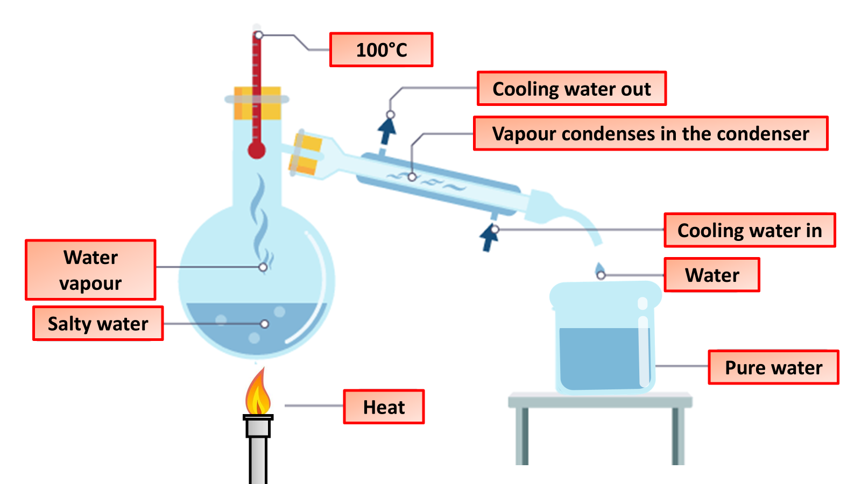

Distillation Practice Question
Sand and salt is an example of a mixture as the sand and the water are not chemically bonded together.
Describe how you could use simple distillation to separate a mixture of water and salt. Explain each step in the process.
Key things to include:
What causes the water to evaporate
How is the water condensed back into a liquid
What is left in the flask
_____________________________________________________________________________________________________________________________________________________________________________________________________________________________________________________________________________________________________________________________________________________________________________________________________________________________________________________________________________________________________________________________________
Answer
Link to video

