Slide 1
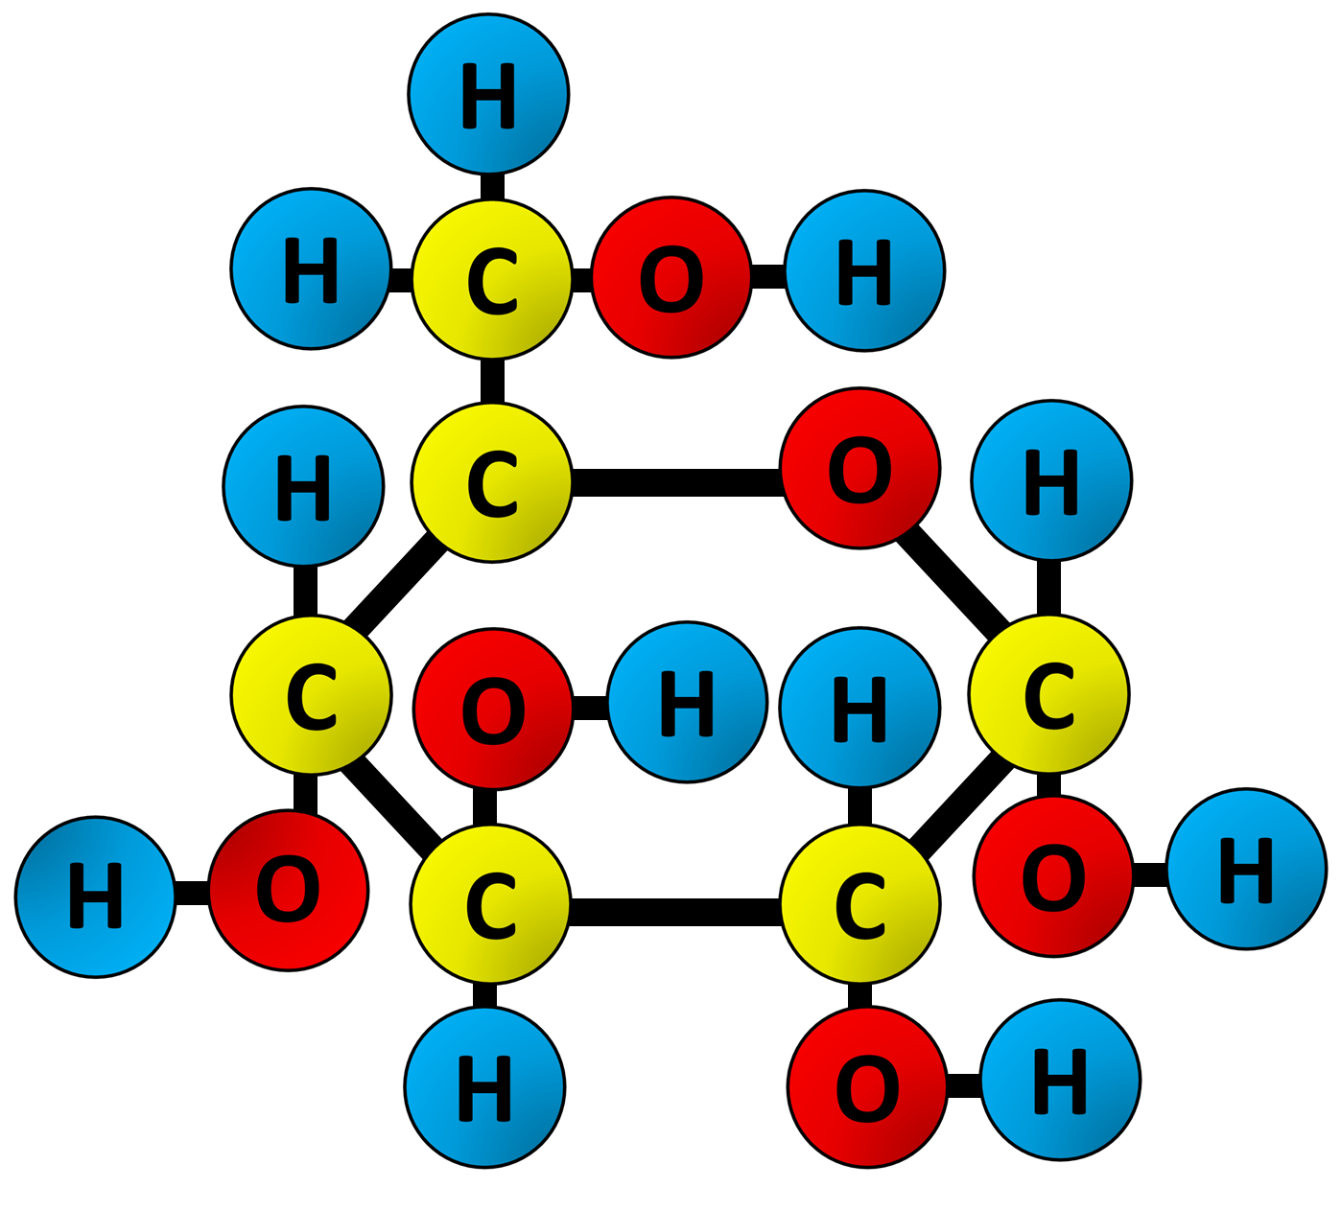

Glucose Question
The diagram below shows the structure of glucose. Describe the structure of a glucose molecule and explain how its structure relates to its function.
________________________________________________________________________________________________________________________________________________________________________________________________________________________________________________________________________________________________________________________________________________________________________________________________________________________________________________________________________________________________________________________________________________________________________________________________________________________________________________________________________________________________________________________________________________________________________________
Answer
Link to video

