Slide 1
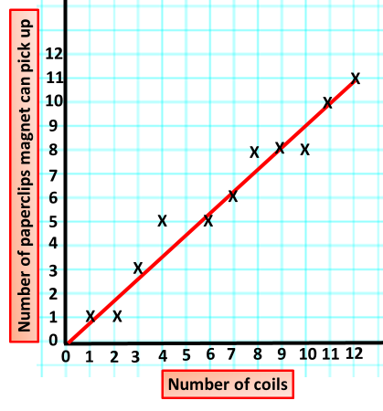

Electromagnet Graph Question
The graph below shows how changing the number of coils on an electromagnet affects it’s strength
Mark Scheme
What happens to the strength of an electromagnet when you increase the number of coils?
Does adding more coils make the magnetic field stronger or weaker?
Why does increasing the number of coils increase the strength of an electromagnet?
What else (besides number of coils) can you change to increase the strength of an electromagnet?

