Slide 1



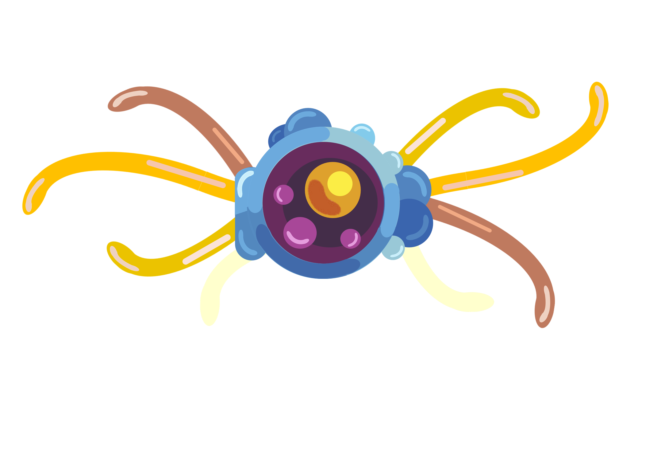

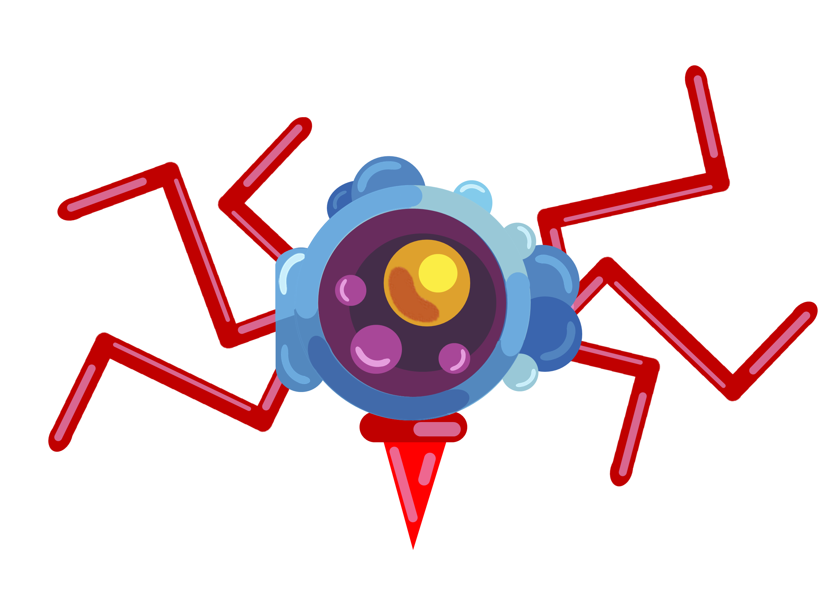
Types of T Cells
Helper T cells are a type of T lymphocyte that play a central role in the adaptive immune response. They recognise antigens presented on MHC II molecules by antigen-presenting cells and become activated. Once activated, helper T cells release cytokines that stimulate B cells, cytotoxic T cells, and phagocytes, coordinating and strengthening the overall immune response.
Memory T cells are long-lived T lymphocytes formed after an initial immune response. They remain in the body and retain the same specific T cell receptors as the original activated T cells. If the same pathogen is encountered again, memory T cells enable a faster and stronger immune response by quickly activating and dividing.
Cytotoxic T cells are a type of T lymphocyte involved in cell-mediated immunity. They recognise antigens presented on MHC I molecules on infected or abnormal body cells. Once activated, they release perforin and granzymes, causing the target cell to undergo apoptosis, which helps eliminate infected or cancerous cells.
Thymus Gland

