Slide 1
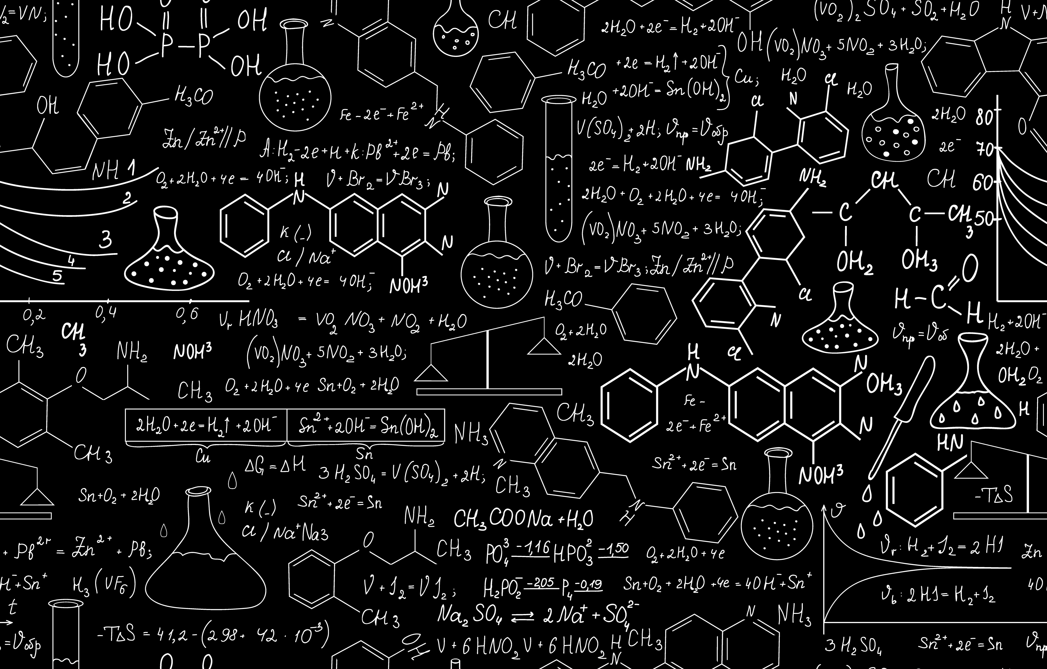
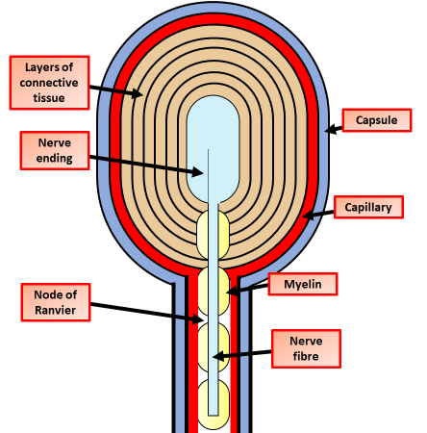
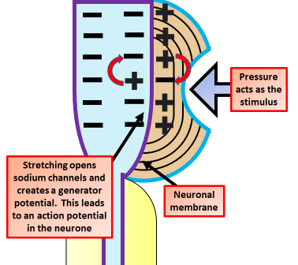
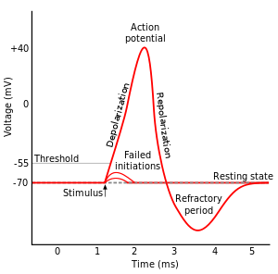
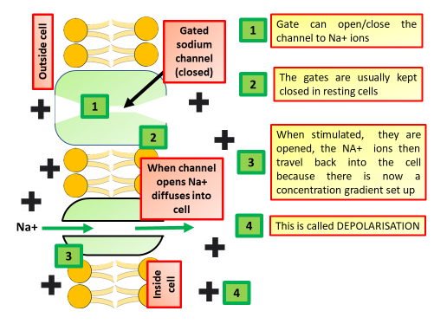
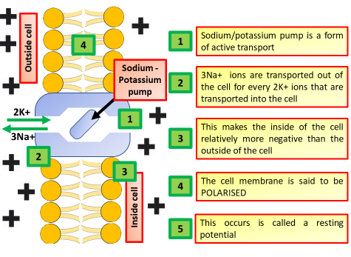
A Level Biology: The Nervous System, Generation of an Action Potential & the Maintenance of a Resting Potential
Pacinian Corpuscles
Generator Potentials
Pacinian corpuscles, are one of the four major types of mechanoreceptor. They are nerve endings in the skin responsible for sensitivity to vibration and pressure. They respond only to sudden disturbances and are especially sensitive to vibration. The vibrational role may be used to detect surface texture, e.g., rough vs. smooth. Lamellar corpuscles are also found in the pancreas, where they detect vibration and possibly very low frequency sounds. Lamellar corpuscles act as very rapidly adapting mechanoreceptors. Groups of corpuscles respond to pressure changes, e.g. on grasping or releasing an object.
At rest, the nerve ending within the Pacinian corpuscle maintains a resting potential of −70 mV, typical of the membrane of a neurone. When localised, strong pressure is applied to a Pacinian corpuscle it causes the layers of collagen of the capsule to be deformed. The outcome is a temporary change to the permeability of the membrane at the nerve ending. Sodium ions flow in, the membrane is depolarised and the interior starts to become less negative. The stronger the stimulus, the greater the depolarisation. If a threshold value is reached, it triggers an impulse in the sensory neurone that serves the sense cell.
Cells when stimulated
Cells at rest
The all-or-none law is the principle that the strength by which a nerve or muscle fiber responds to a stimulus is independent of the strength of the stimulus. If that stimulus exceeds the threshold potential, the nerve or muscle fiber will give a complete response; otherwise, there is no response.

