Slide 1
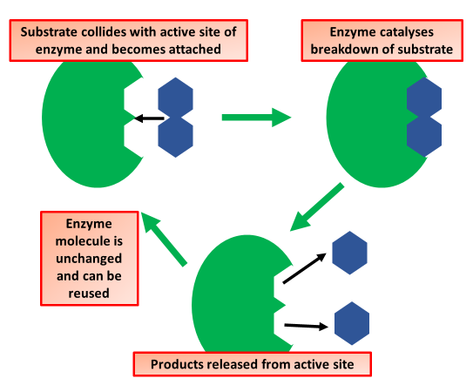

Induced Fit Model Question
Describe the induced fit model of enzyme action and explain how it differs from the lock and key model.
___________________________________________________________________________________________________________________________________________________________________________________________________________________________________________________________________________________________________________________________________________________________________________________________________________________________________________________________________________________________________________________________________________________________________________________________________________________________________
Answer
Link to video

