Slide 1

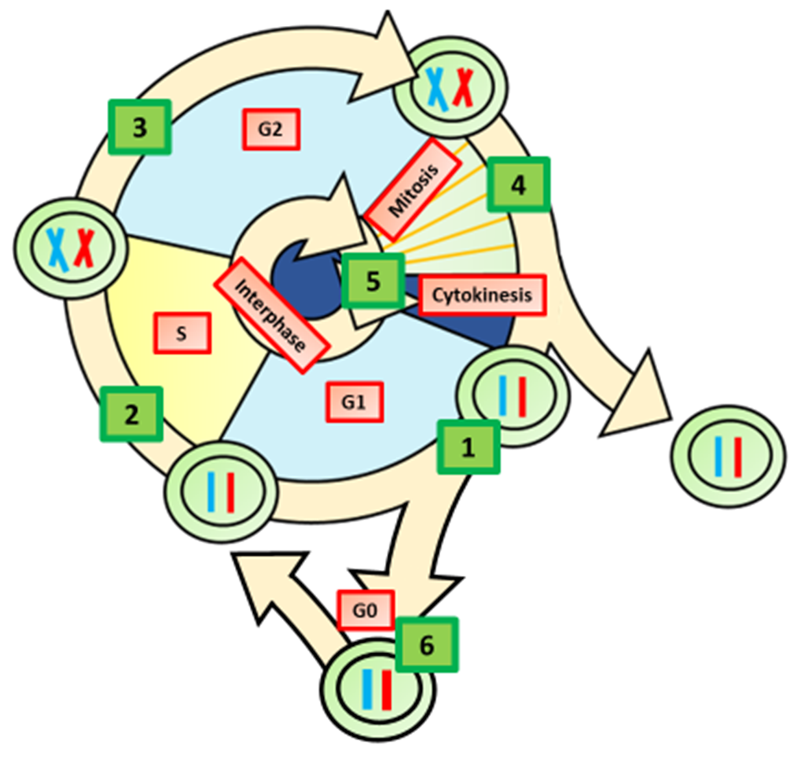

The Great Biology Pubish Quiz
The Cell Cycle

Slide 2

The Great Biology Pubish Quiz
The Cell Cycle
Which phase of the cell cycle is the longest?
A
G1 phase
M phase
B
C
S phase
D
G2 phase

Slide 3
The Great Biology Pubish Quiz
The Cell Cycle
During which phase does DNA replication occur?
A
G1 phase
S phase
B
C
G2 phase
D
M phase

Slide 4
The Great Biology Pubish Quiz
The Cell Cycle
What is the main purpose of mitosis?
A
To produce gametes
To create genetic variation
B
C
To produce identical daughter cells
D
To synthesize proteins

Slide 5
The Great Biology Pubish Quiz
The Cell Cycle
In which stage of mitosis do sister chromatids separate?
A
Prophase
Metaphase
B
C
Anaphase
D
Telophase

Slide 6
The Great Biology Pubish Quiz
The Cell Cycle
What is the role of checkpoints in the cell cycle?
A
To speed up the process
To stop cell division permanently
B
C
To duplicate organelles
D
To repair DNA and prevent errors

Slide 7
The Great Biology Pubish Quiz
The Cell Cycle
Which phase directly follows mitosis?
A
S phase
B
G2 phase
C
Interphase
D
G1 phase

Slide 8

The Great Biology Pubish Quiz
The Cell Cycle
Question 1
A
Question 2
B
Question 3
C
Question 4
C
Question 5
D
Question 6
D

