Slide 1
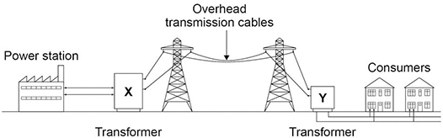

National Grid Practice Question
The figure below shows how electricity is supplied to consumers by the National Grid.
Explain why transformer X is used in the National Grid.
Key things to include:
What sort of transformer X is
How the current and PD changes
How is energy saved
_______________________________________________________________________________________________________________________________________________________________________________________________________________________________________________________________________________________________________________________________________________________________________________________________________________________________________________________________________________
Answer
Link to video

Slide 2
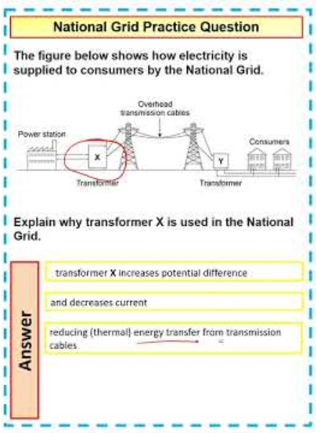
National Grid Practice Question

