Slide 1

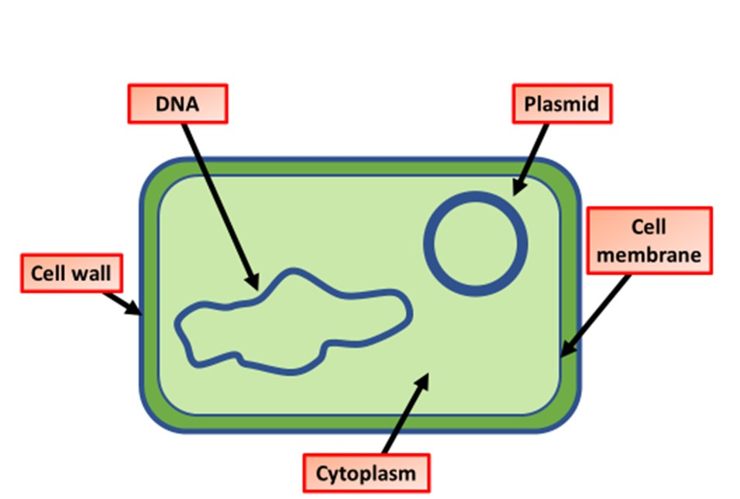

The Great Biology Pubish Quiz
Prokaryotic vs eukaryotic

Slide 2

The Great Biology Pubish Quiz
Prokaryotic vs eukaryotic
Which of the following structures is found in eukaryotic cells but not in prokaryotic cells?
A
Ribosomes
Cytoplasm
B
C
Nucleus
D
Cell membrane

Slide 3
The Great Biology Pubish Quiz
Prokaryotic vs eukaryotic
Which type of cell has DNA in a circular form?
A
Prokaryotic cell
Animal cell
B
C
Plant cell
D
Fungal cell

Slide 4
The Great Biology Pubish Quiz
Prokaryotic vs eukaryotic
What is the function of plasmids in prokaryotic cells?
A
Protein synthesis
Energy production
B
C
Storage of extra genetic material
D
Structural support

Slide 5
The Great Biology Pubish Quiz
Prokaryotic vs eukaryotic
Which organelle is involved in protein synthesis and found in both cell types?
A
Golgi apparatus
Nucleus
B
C
Lysosome
D
Ribosome

Slide 6
The Great Biology Pubish Quiz
Prokaryotic vs eukaryotic
Which of these is a feature unique to prokaryotic cells?
A
Peptidoglycan cell wall
80S ribosomes
B
C
Membrane-bound organelles
D
Mitochondria

Slide 7
The Great Biology Pubish Quiz
Prokaryotic vs eukaryotic
What term describes cells that contain membrane-bound organelles?
A
Eukaryotic
B
Prokaryotic
C
Viral
D
Binary

Slide 8

The Great Biology Pubish Quiz
Prokaryotic vs eukaryotic
Question 1
C
Question 2
A
Question 3
C
Question 4
D
Question 5
A
Question 6
A

