Slide 1
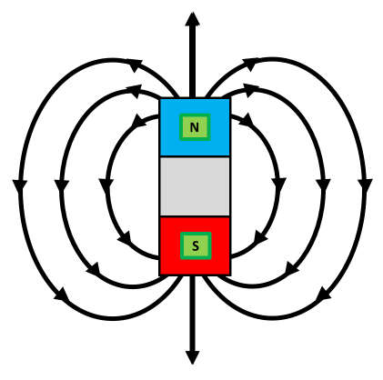

Magnetic Fields Question
The diagram below shows magnetic field lines around a magnet
Mark Scheme
What is the region around a magnet where magnetic forces act called?
What shape do magnetic field lines form around a bar magnet?
In which direction do magnetic field lines go outside a magnet?
What happens to the strength of a magnetic field as you move further from the magnet?

