Slide 1
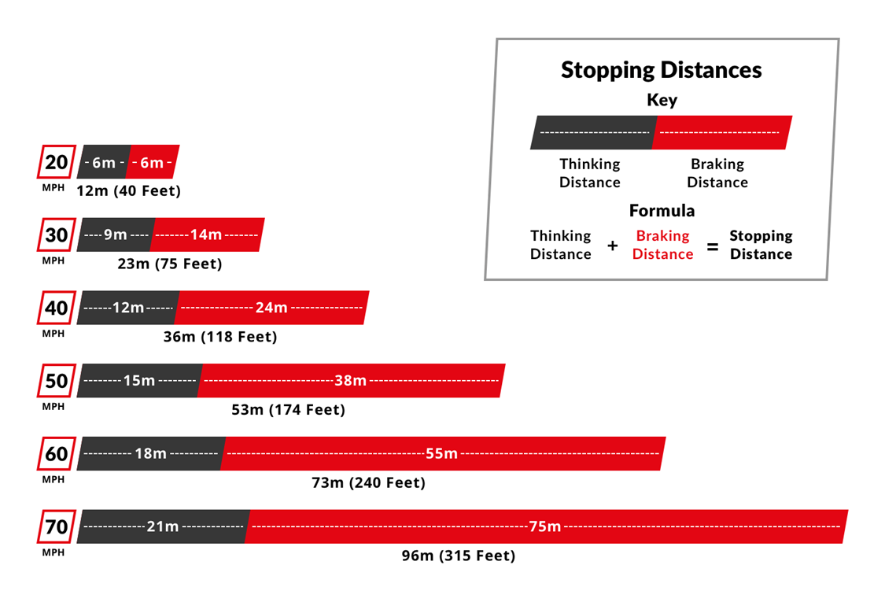

Stopping Distance Practice Question
In an emergency the driver needs to apply the brakes suddenly to stop the car quickly. The driver of the car is distracted.
Explain why the distraction will increase the stopping distance.
Key things to include:
What is stopping distance made up of
How does increasing thinking distance increase breaking distance
Answer
_____________________________________________________________________________________________________________________________________________________________________________________________________________________________________________________________________________________________________________________________________
Link to video

Slide 2
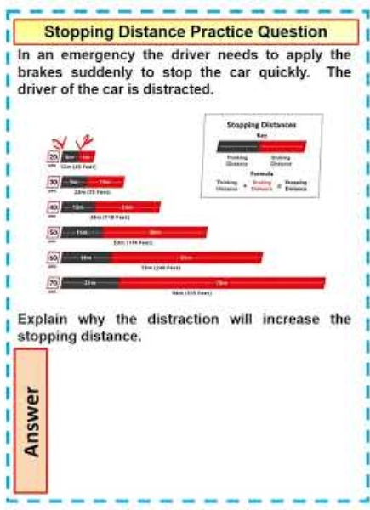
Stopping Distance Practice Question

